Slide 1


Welcome to the Stevens Creek Elementary Chess Club!
Rusty Charles
Columbia County Chess Association

Slide 2



STCE Chess Club – Session 1
Files and Ranks
Purpose of the Game
Introduction of pieces and how they move
  Pawns
  Knights
  Bishops
  Rooks
  Queen
  King

Slide 3
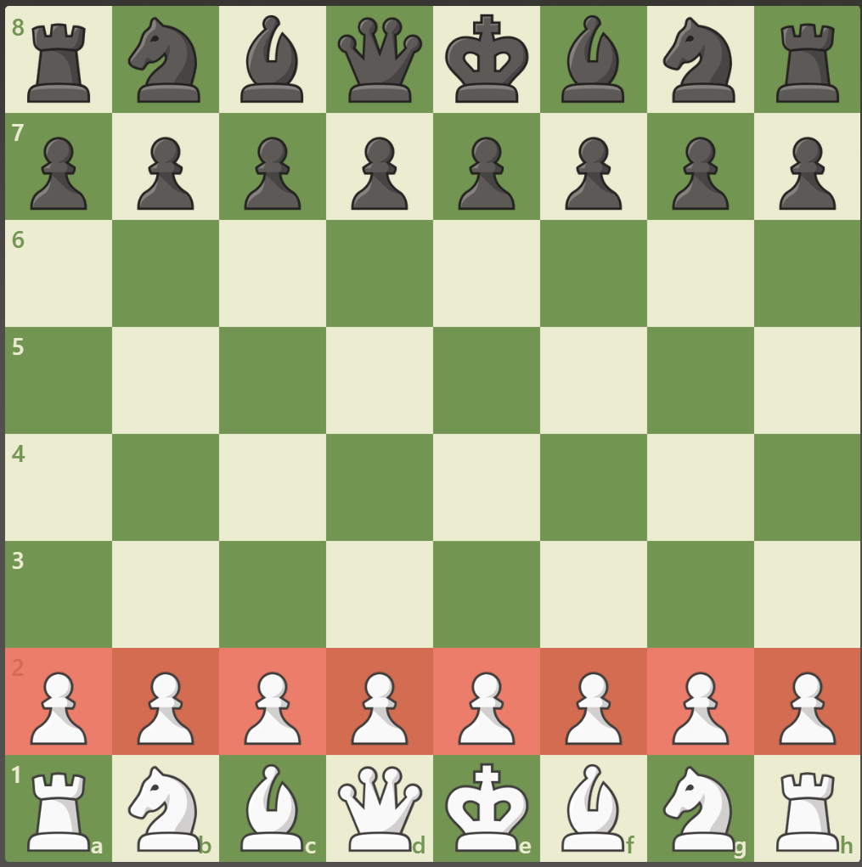
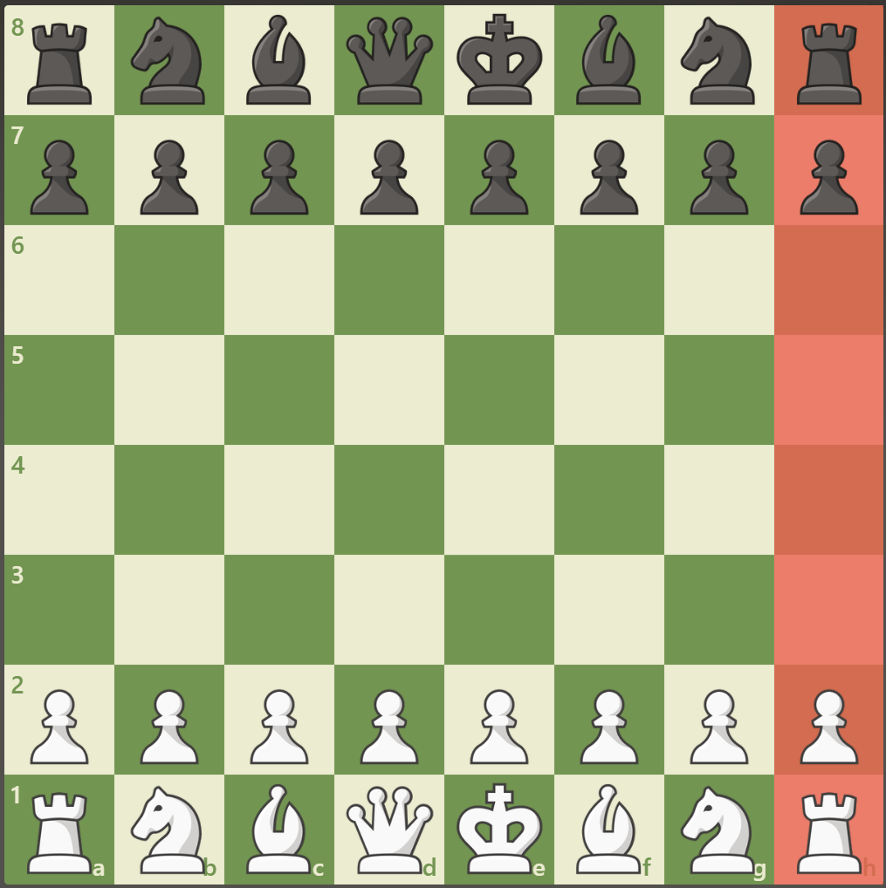
Ranks
Horizontal (or row) on a chess board
Each rank is assigned a number
Example: All pawns start on the 2nd rank
Files
Vertical (or columns) on a chess board
Each file is assigned a letter
Example: All rooks may progress up the board along files

Slide 4
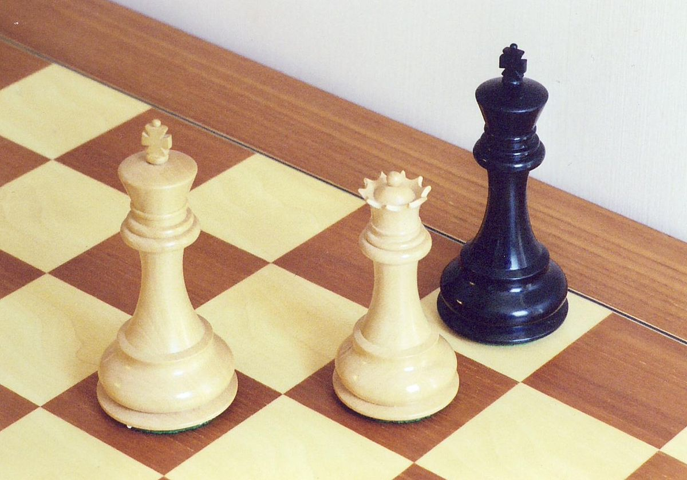
Purpose of the game
Purpose: Capture the King!
Many starting players enjoy moving pieces around and taking all the others, but one should not forget that the to win the game all that has to be done is to capture the king!

Slide 5

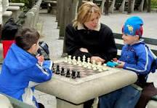
Piece Introduction
Piece Introduction and how they move

Slide 6
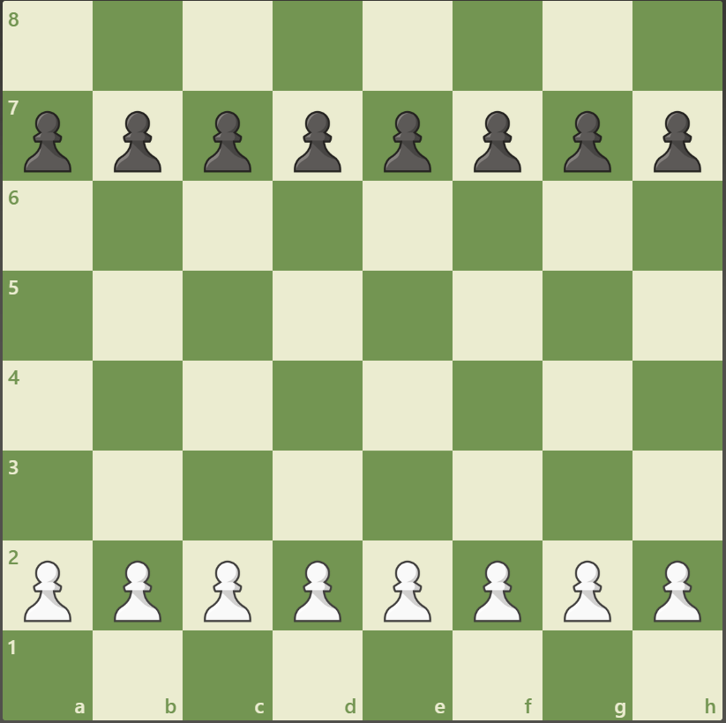
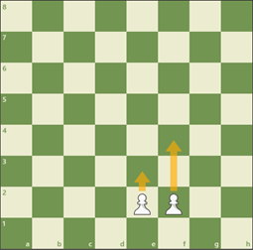
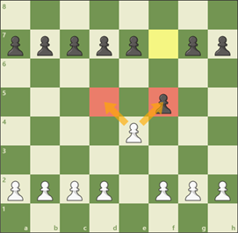


Pawns
Starting position
Pawns - starting moves
Pawns always
capture diagonally
Pawns turn into any piece they want
to once they get to the back (8th) rank
Starting Position: Start across the 2nd Rank
How they move:
From the starting position – 1 or 2 spaces forward
After the start – 1 space forward
How they capture: Pawns only capture diagonally
Special abilities: If a pawn progresses all the way to the back rank, the pawn can become any piece it wants to
Queen, Rook, Bishop or Knight
En Passant

Slide 7
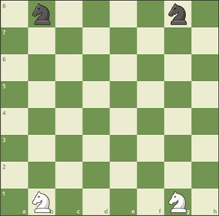
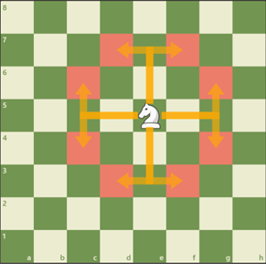
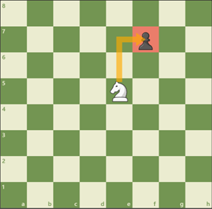
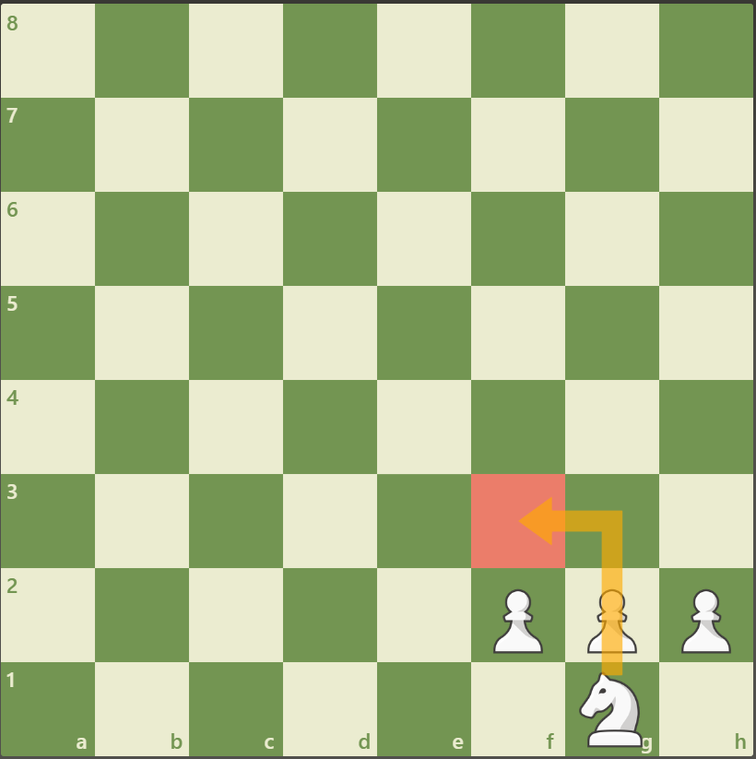



Knights
Starting position
Knights move in an “L” shape,
Two space in one direction and
then one space to the side
Knights capture by landing
on an occupied space
Knights are the only pieces allowed
to jump over others
Starting Position: Start across back rank, on the B- and G-files
How they move:
Move like an “L”
They move two spaces in one direction, and one perpendicular (to the side)
How they capture: Knights capture by landing on an occupied space
Special abilities: The knight is the only piece allowed to jump over other pieces

Slide 8
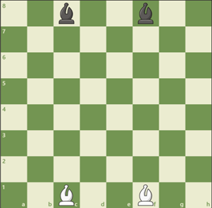
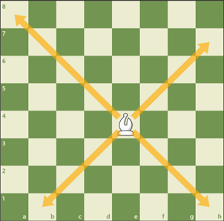
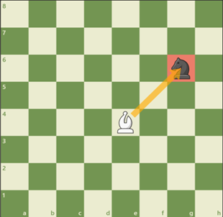
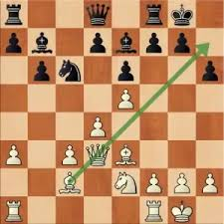


Bishops
Starting position
Bishops only move diagonally
and stay on their own color
Bishops capture by landing
on an occupied space
Bishops can be used in powerful
“batteries” to gain checkmates
Starting Position: Start across back rank, on the C- and F-files
How they move:
Bishops only move diagonally
Bishops move as many squares as they like but cannot jump or pass through another piece
They can only stay on their color space
How Bishops capture: Bishops capture by landing on an occupied space
Special abilities: Bishops can be used in “batteries” with the Queen to achieve checkmates

Slide 9
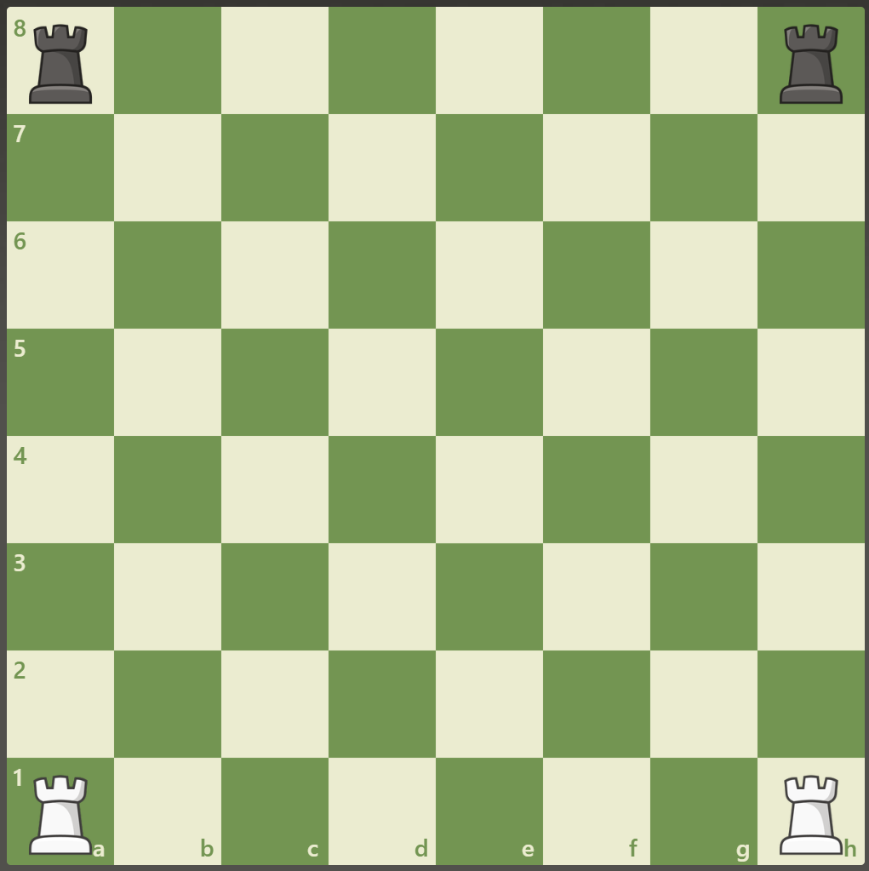


Rooks
Starting position
Rooks can move along ranks or files
Rooks capture by landing on
an opponents piece
Rooks can be used in powerful
“batteries” to gain checkmates
Starting Position:
The Rook starts on the back rank, on the A- and H-files
How they move:
Rooks can move in a straight line along ranks (sideways) or files (up and down)
How Rooks capture:
Rooks capture by landing on an opponents piece
Special abilities:
Rooks can be used in “batteries” with the other rook or Queen achieve checkmates
Rooks are used in Castling

Slide 10
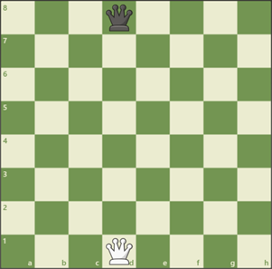
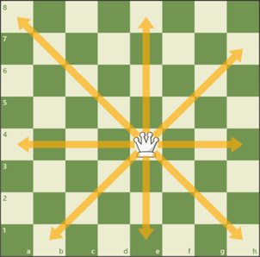
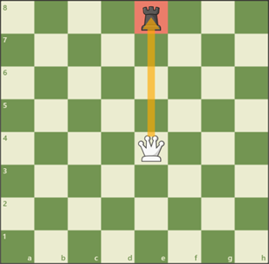


Queens
Starting position
(on their own color)
Queens can move in any
direction in a straight line
Queens capture by landing
on an occupied space
Queens can be used in powerful
“batteries” to gain checkmates
Starting Position:
The Queen starts on the back rank, on either the D- or E-file
The Queen always starts on their on color
How they move:
Queens can move in any direction in a straight line
Queens can not pass through (or jump) over pieces
How Queens capture: Queens capture by landing on an occupied space
Special abilities:
Queens can be used in “batteries” with the Bishops or Rooks to achieve checkmates
Queens are considered the most powerful piece on the board

Slide 11
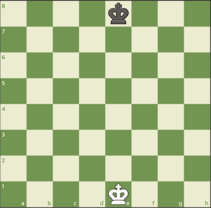
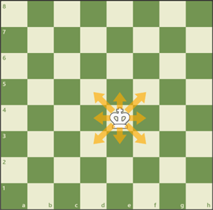
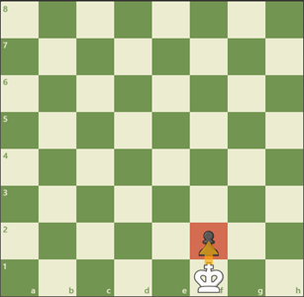
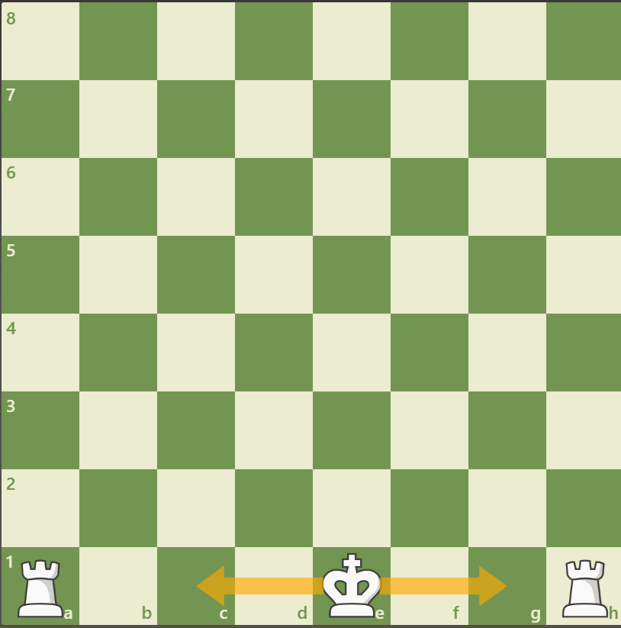
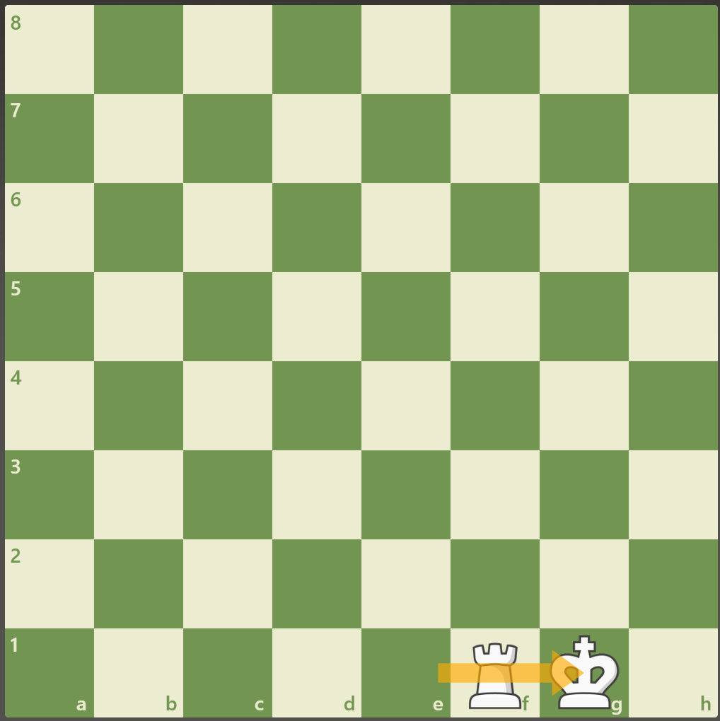
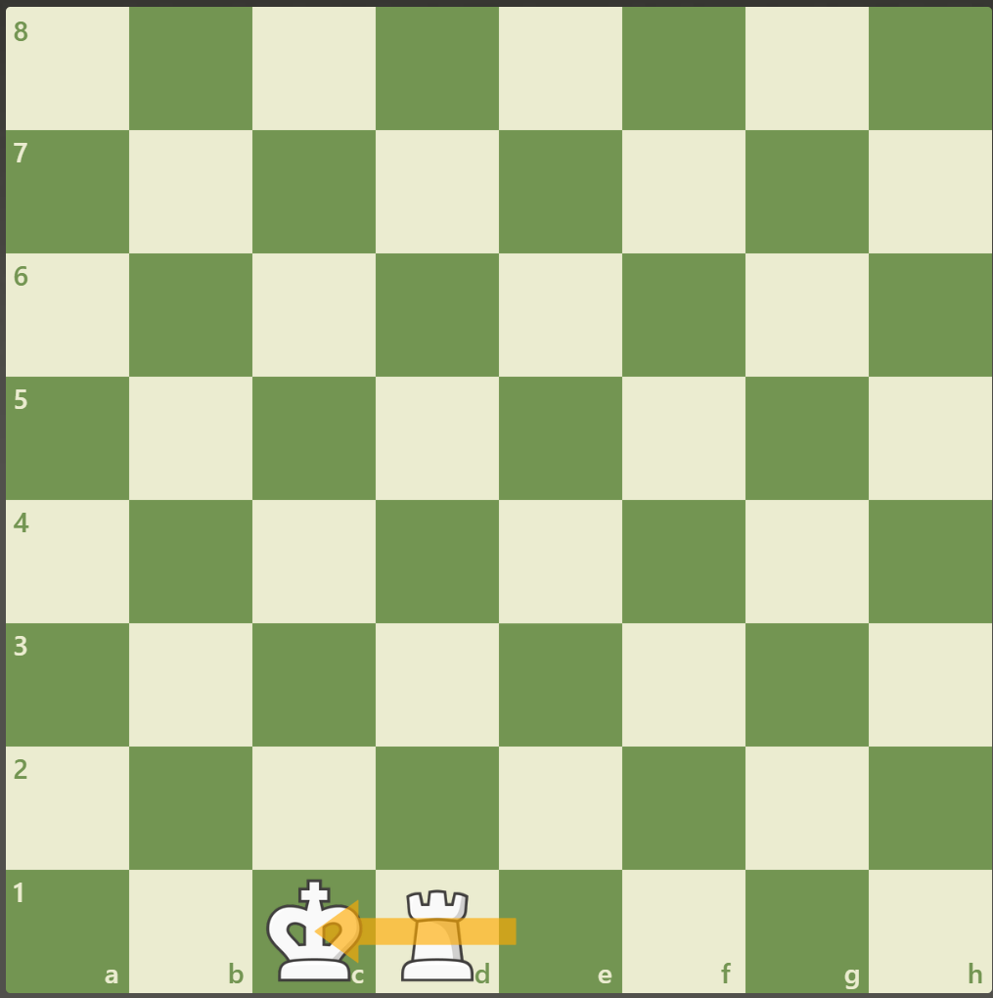
Kings
Starting position
Kings can move in any direction,
but only one space at a time
Kings capture by landing
on an occupied space
The only time Kings can move 2
spaces is when they castle
Starting Position:
The King starts on the back rank, on either the D- or E-file
The King always takes the color opposite his
How Kings move:
Kings move in any direction, but only one space at a time
How Kings capture: Kings capture by landing on an occupied space
Castling Short (Kingside)
Castling Long (Queenside)
Special abilities:
A King can castle and move two spaces if
  There are no pieces in between the King and Rook
  The King does not pass through a check
  The King has not moved yet

Slide 12

Let’s Play!
Presenter Name
Email
Website

