Slide 1
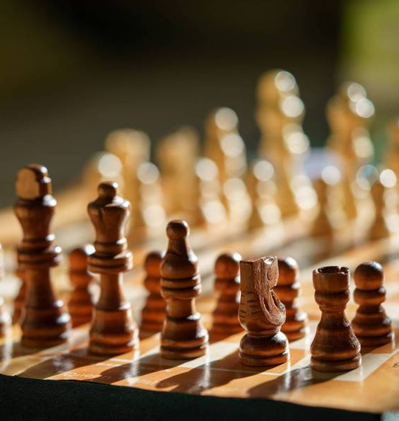

Welcome to the Stevens Creek Elementary Chess Club!
Mrs. Ennis
Rusty Charles
Columbia County Chess Association

Slide 2



STCE Chess Club –
Rules and Expectations
Etiquette
  Always be respectful
  Do not argue with your opponent
    Call a teacher over if there is a problem
  Do not throw or be sloppy with pieces
    All pieces should stay on the table
  We are here to learn and have fun

Slide 3
STCE Chess Club – Session 2
Definitions: Controlling squares
Parts of a Chess Game
Concepts for the Opening
  Control the Center
  Get your pieces out
  Protect the King
Giouco Piano

Slide 4
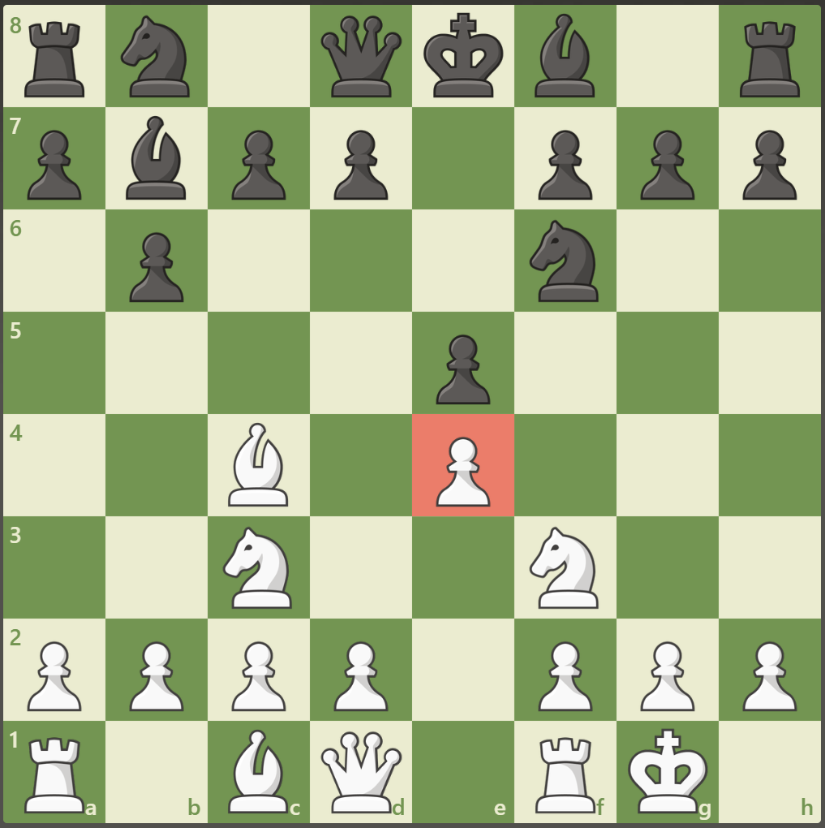
Controlling Square
When a players has more defenders of a square than their opponent
If a player has more attackers of a square than their opponent, it is time to ATTACK!

Slide 5
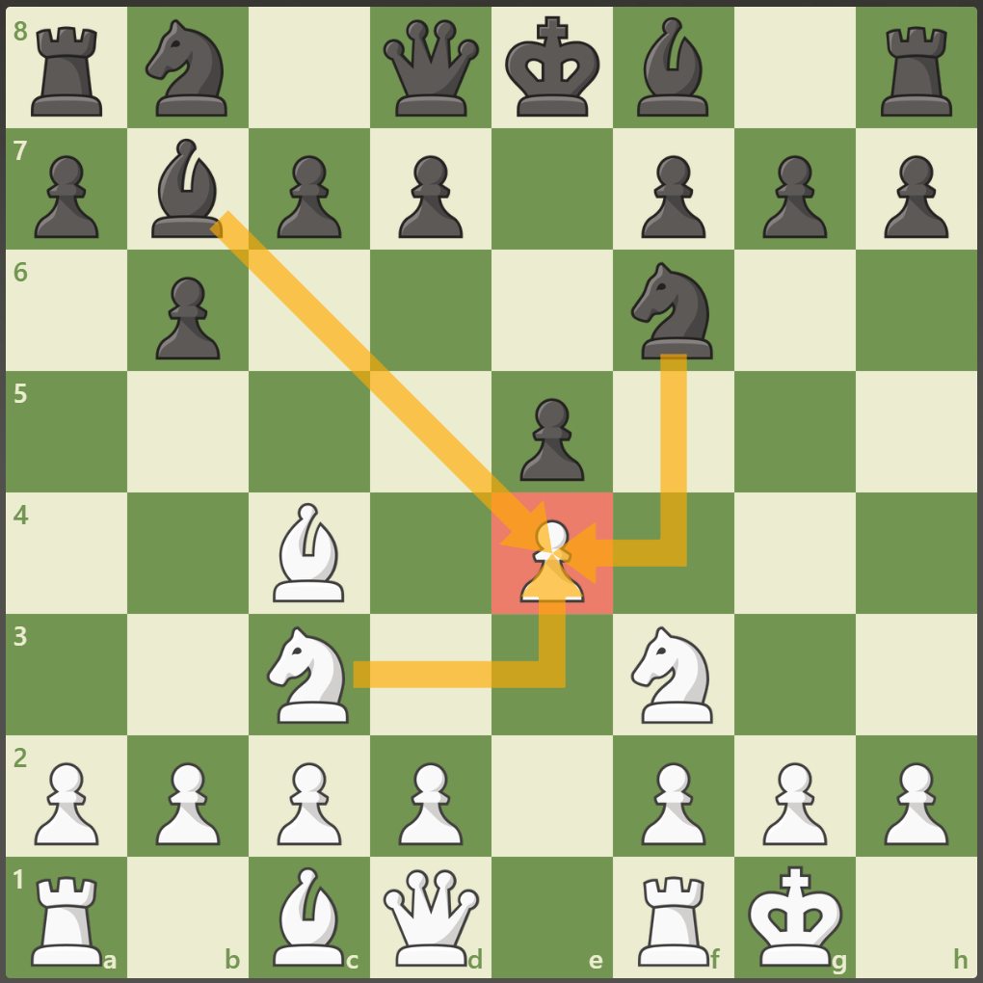
Controlling Square
When a players has more defenders of a square than their opponent
If a player has more attackers of a square than their opponent, it is time to ATTACK!
The position points to the E4 square where it is defended by White with a one piece but is attacked by two of black’s pieces
  Black should take with either the bishop of the knight because they CONTROL that square

Slide 6
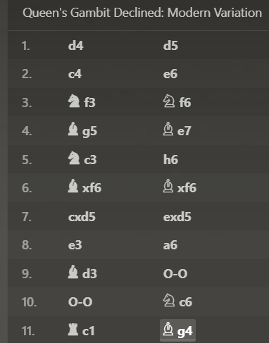
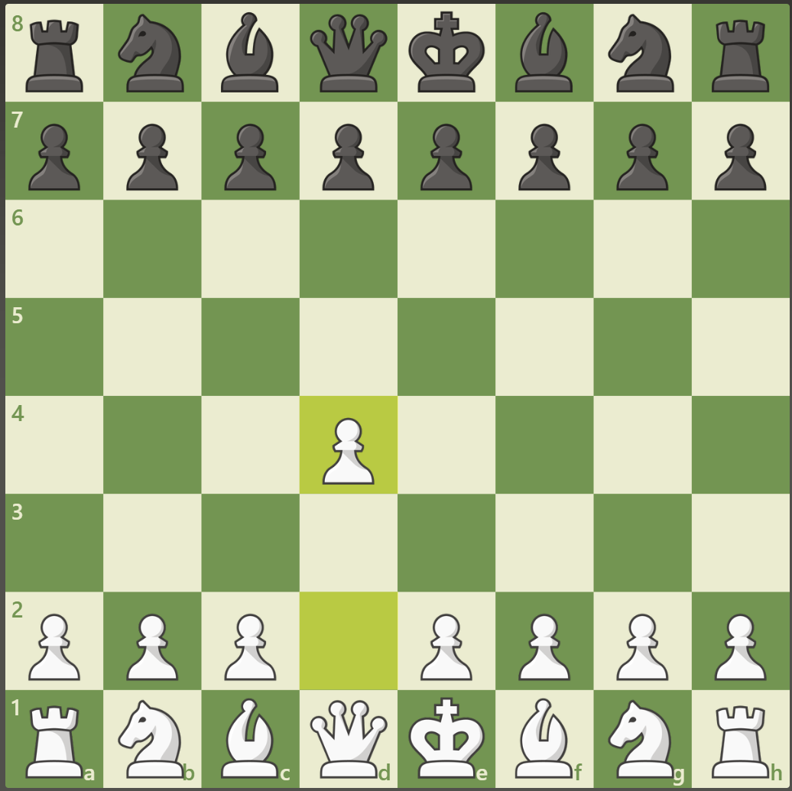
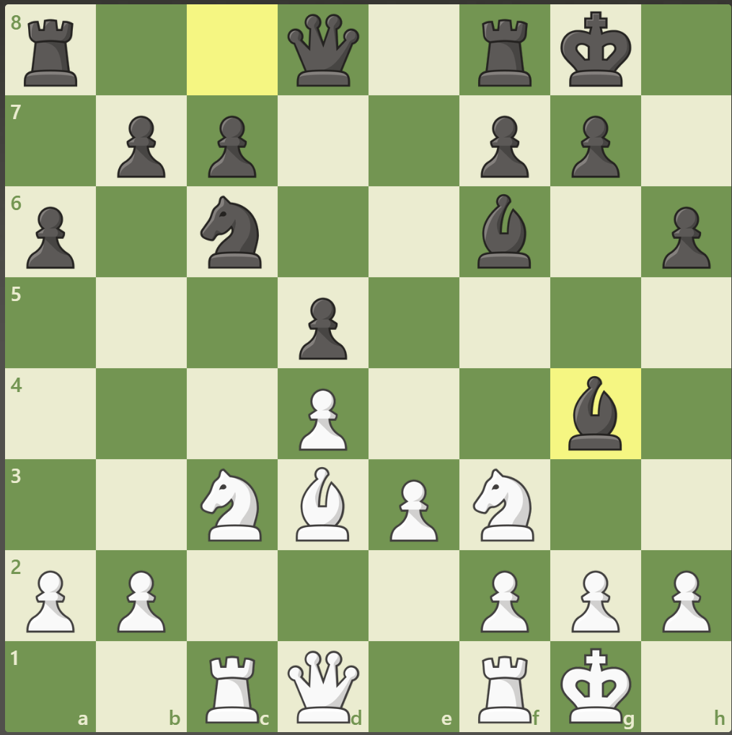
Parts of a Chess Game
Opening – Try to get your pieces out and protect your king

Slide 7
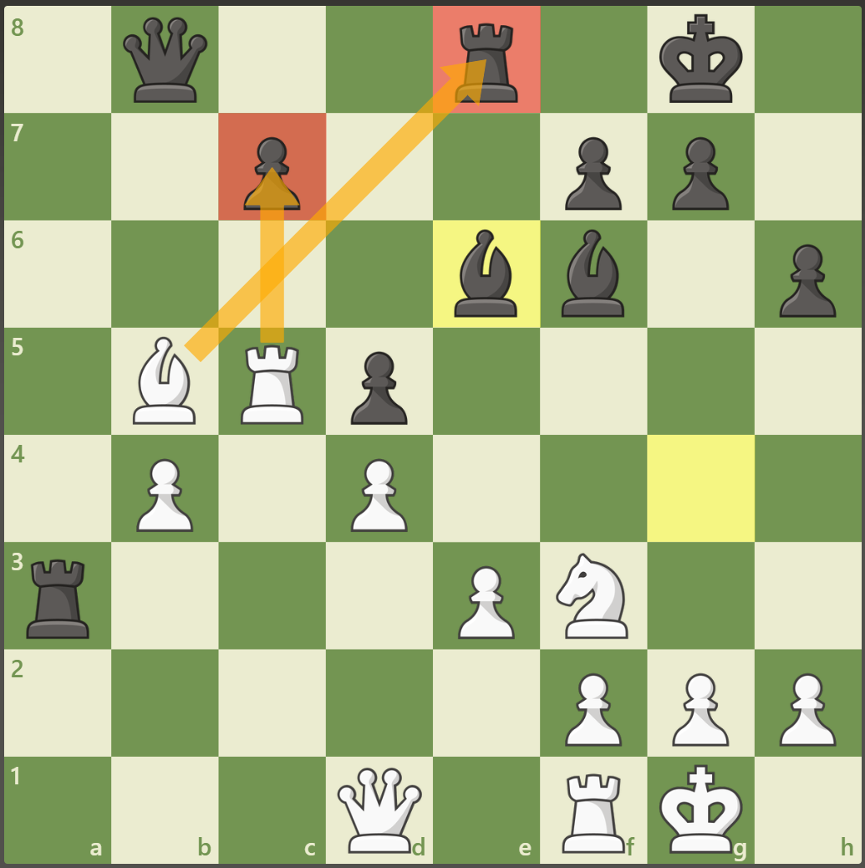
Parts of a Chess Game
Opening – Try to get your pieces out and protect your king
Middle game – Advancing / Positioning pieces working to checkmate the opponent

Slide 8
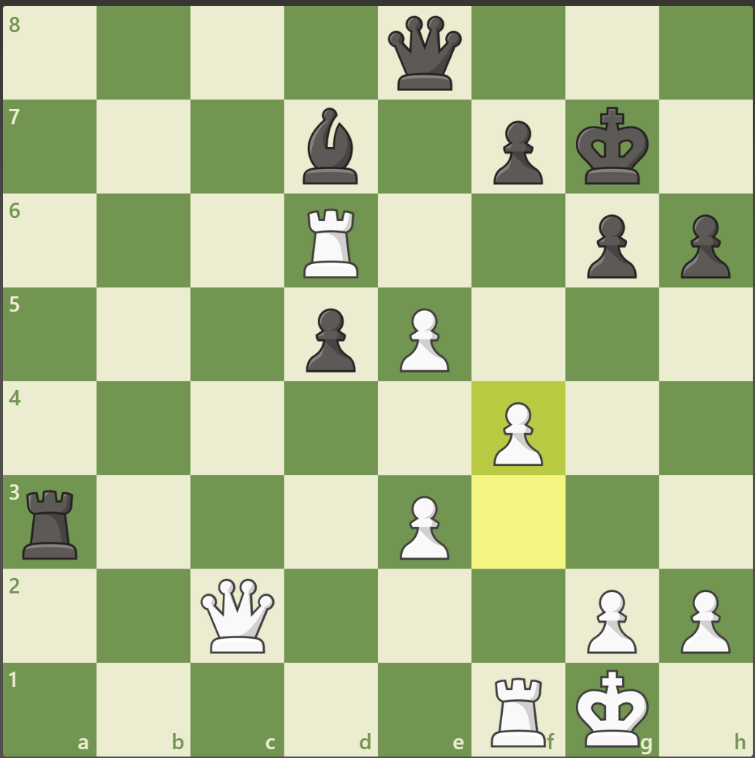
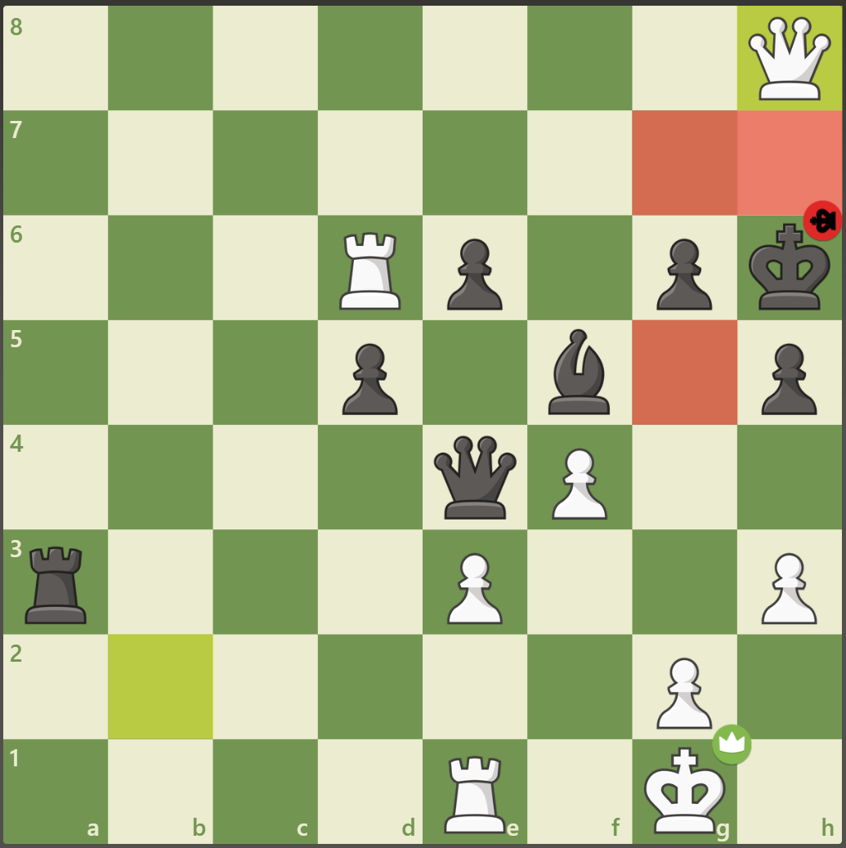
Parts of a Chess Game
Opening – Try to get your pieces out and protect your king
Middle game – Advancing . Positioning pieces working to checkmate the opponent
Endgame – The final attack on an opponents King

Slide 9
Concepts for the Opening
Concepts for the Opening
  Control the Center
  Get your pieces out
  Protect the King

Slide 10
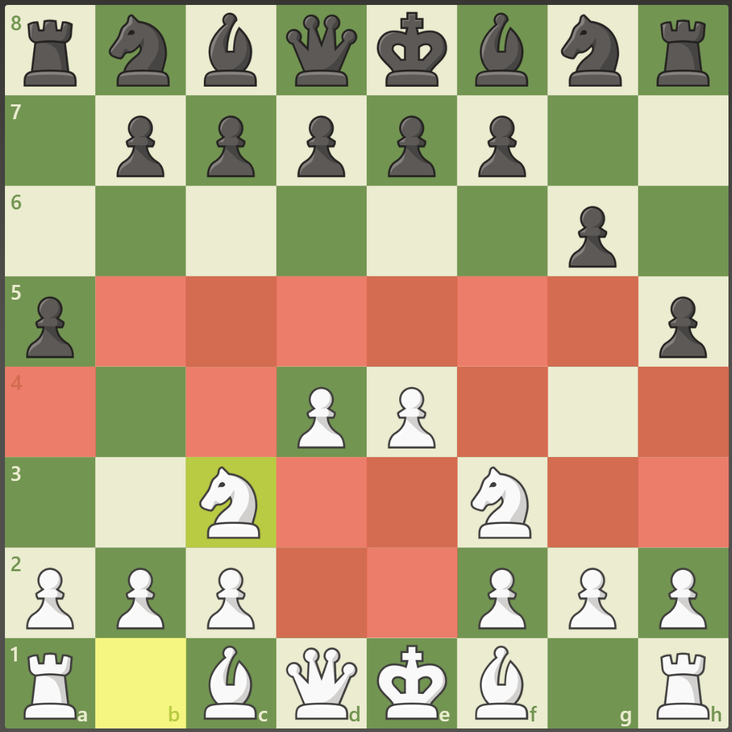
Concepts for the Opening
Concepts for the Opening
  Control the Center
    Controlling the center of the chess board controls the game
    Easier to make things happen and slows your opponent down

Slide 11
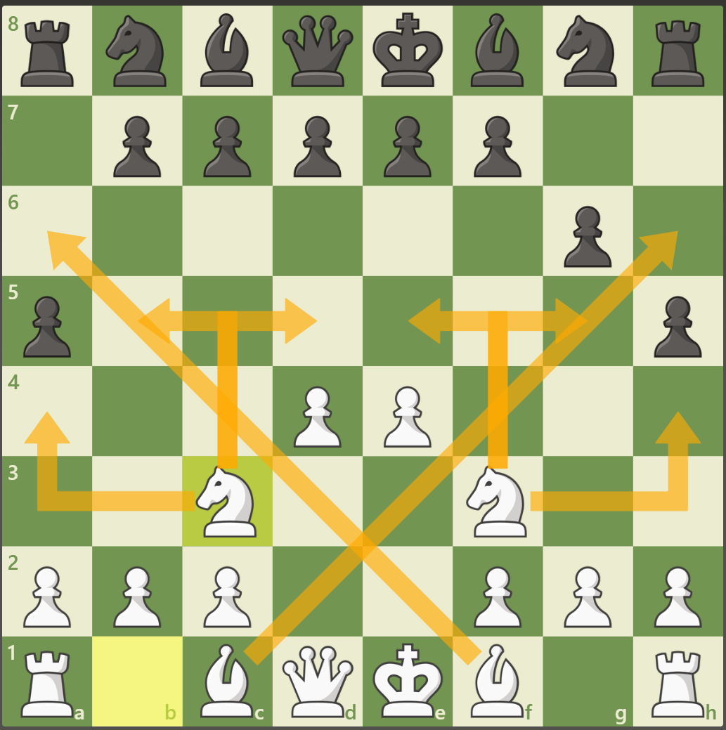
Concepts for the Opening
Concepts for the Opening
  Control the Center
  Get your pieces out
    Ready your pieces where they can have space
    Protect each other
    Begin to plot attacks on your opponent

Slide 12
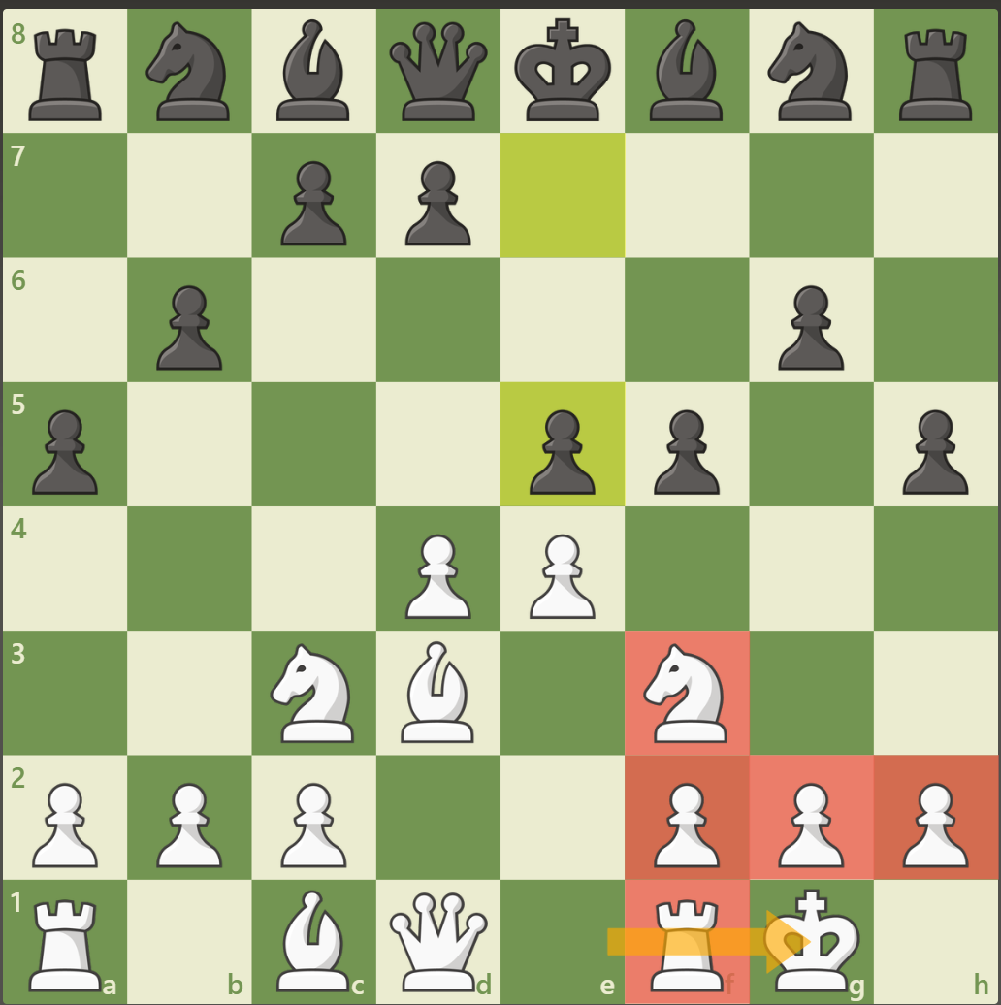
Concepts for the Opening
Concepts for the Opening
  Control the Center
  Get your pieces out
  Protect the King
    Keep defenders around your King for protection
    Castling helps
    Keep your pawns tight around you King

Slide 13
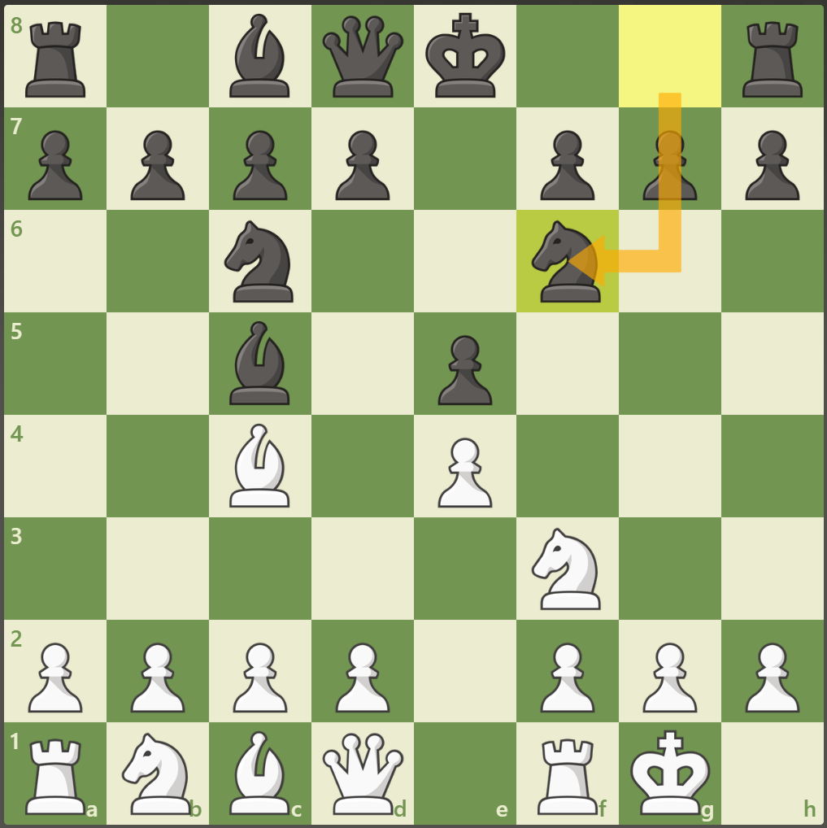
Giuoco Piano
Opening that utilizes all the opening concepts
Control the Center
Get your pieces out
Protect your King

Slide 14
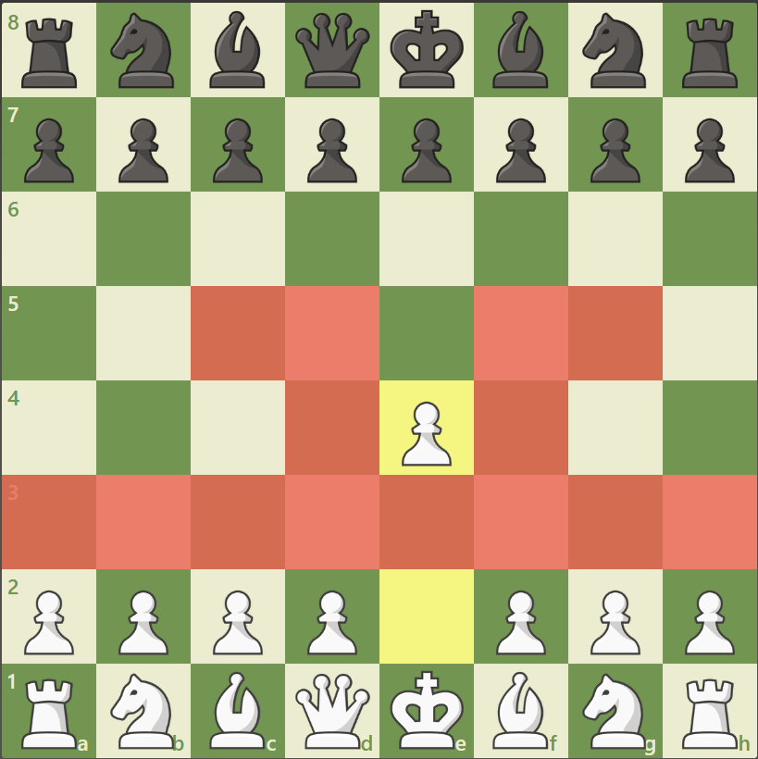
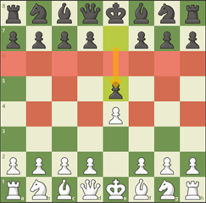
Giuoco Piano
1. e4 e5
Commentary
Begins to open lanes for the Queen and Bishop
Takes a piece of the Center

Slide 15
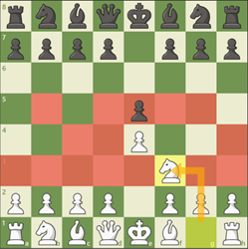
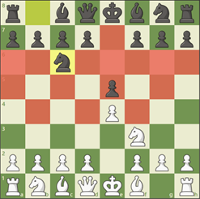
Giuoco Piano
e4 e5
Nf3 Nc6
Commentary
Add an attacker / defender of the e5 square
Begins to get pieces out

Slide 16
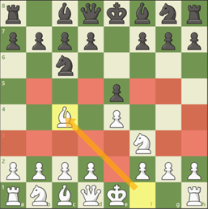
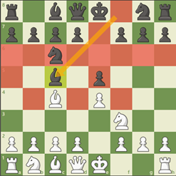
Giuoco Piano
e4 e5
Nf3 Nc6
Bc4 Bc5
Commentary
Prepares to King for castling
Continues to get pieces out
Takes increased ownership of squares

Slide 17
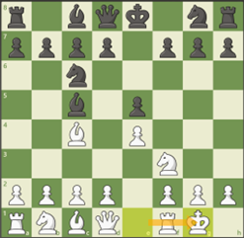
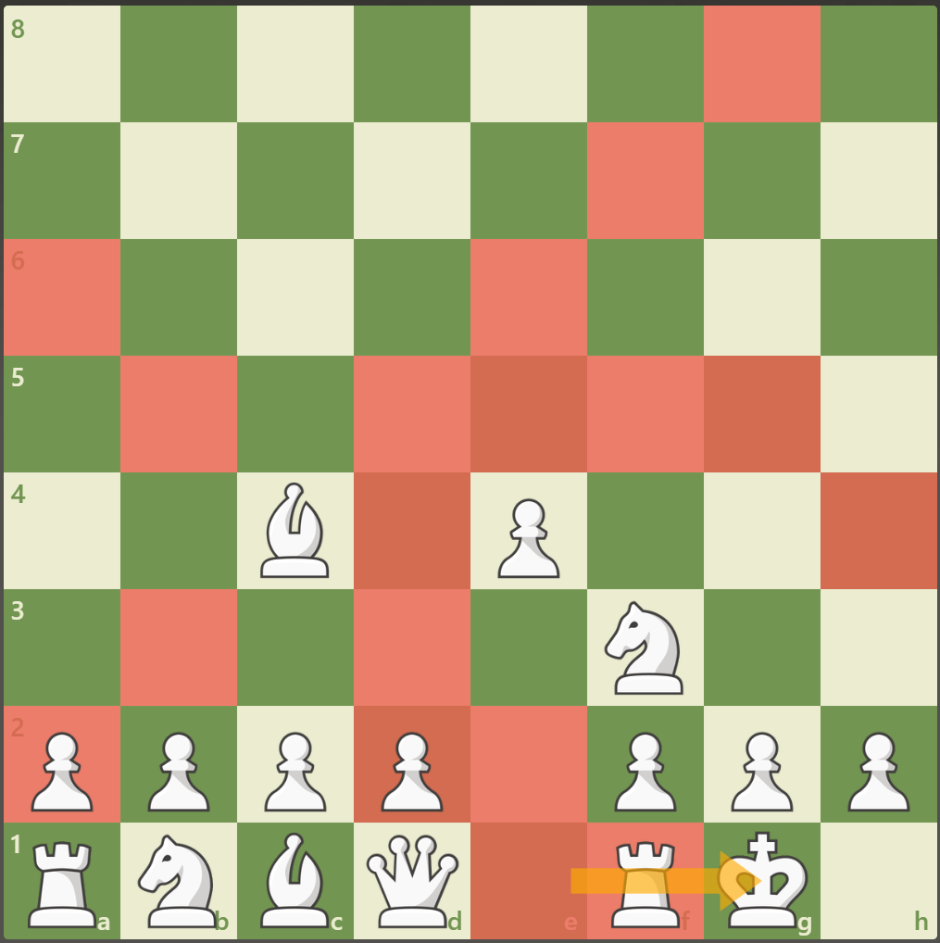
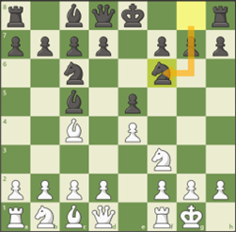
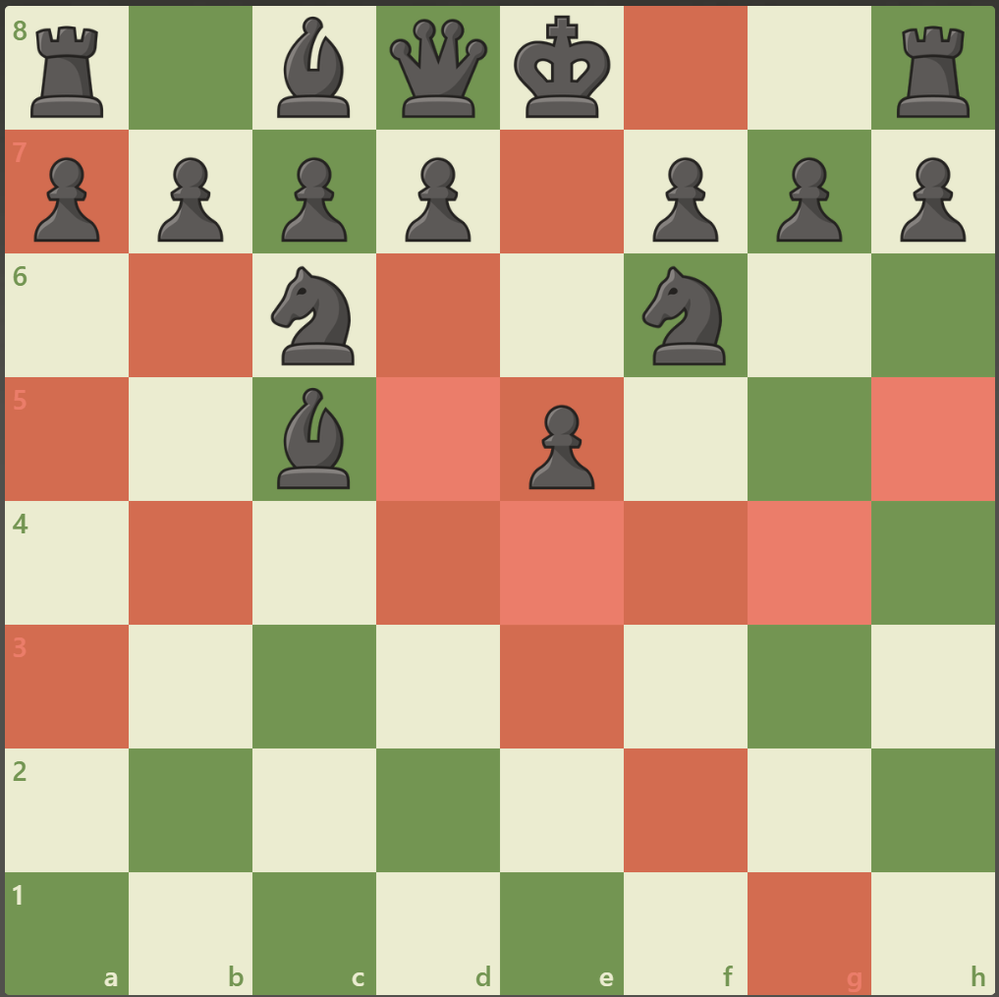
Giuoco Piano
e4 e5
Nf3 Nc6
Bc4 Bc5
0-0 Nf6
White Control of Squares
Commentary
White complete the protection of their King
Black adds an attacker to the e5 Square
Black is now ready to Castle
Both black and white have competitive games
Black Control of Squares

Slide 18
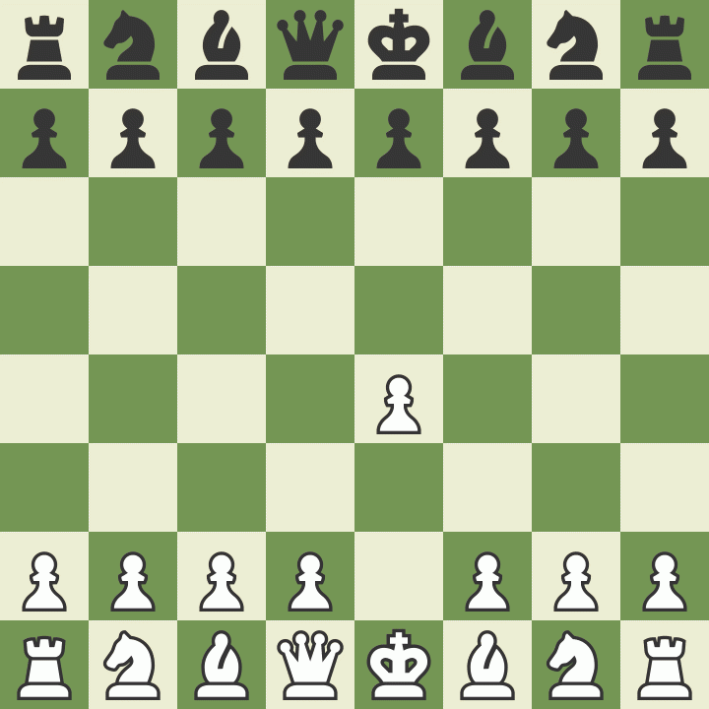
Giuoco Piano
Accomplishes all the goals of the opening
Controls the Center
Gets your pieces out
Protects your king
e4 e5
Nf3 Nc6
Bc4 Bc5
0-0 Nf6

Slide 19
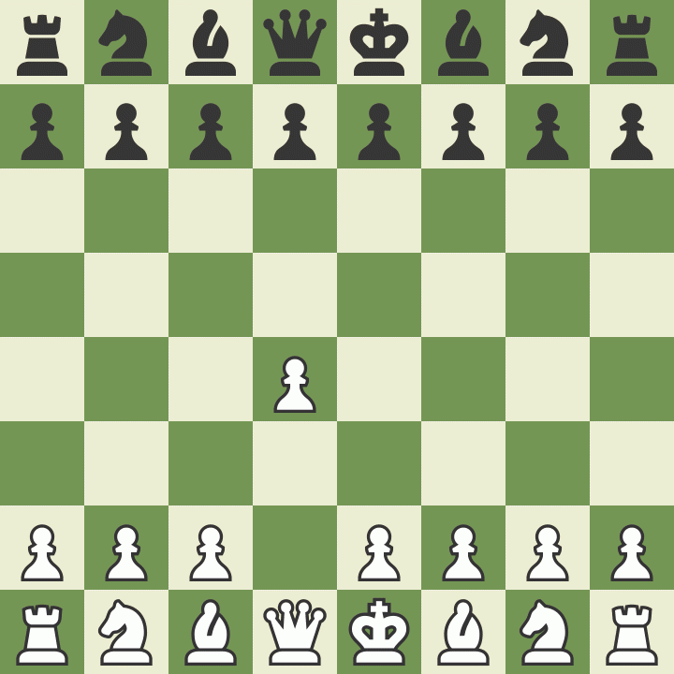
Let’s Play!
Mrs. Ennis
Rusty Charles
Columbiacounty.chess@gmail.com

