Slide 1
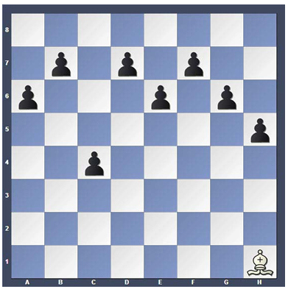
Arrival Activity
How many moves does it take to capture all the pawns with the bishop?
If the pawns don’t move
If both sides can move

Slide 2


Welcome to the Stevens Creek Elementary Chess Club!
Mrs. Ennis
Rusty Charles
Columbia County Chess Association

Slide 3



STCE Chess Club –
Rules and Expectations
Etiquette
  Always be respectful
  Do not argue with your opponent
    Call a teacher over if there is a problem
  Do not throw or be sloppy with pieces
    All pieces should stay on the table
  We are here to learn and have fun

Slide 4
STCE Chess Club – Session 2
Point Values of pieces
Pawns
  Starting moves
  Captures
    En Passant
  Working Together - Structures
Bishops
  Movements
  Good vs. Bad Bishops
  Bishop pairs
Pawn Games

Slide 5






Piece Values
It is important to know that some pieces are considered more valuable than others. This helps us understand and calculate exchanges.
King –
Bishop –
Queen –
Knight –
Rook –
Pawn –

Slide 6
Piece Values
It is important to know that some pieces are considered more valuable than others. This helps us understand and calculate exchanges.
King – Infinite!
Bishop –
Queen –
Knight -
Rook –
Pawn -

Slide 7
Piece Values
It is important to know that some pieces are considered more valuable than others. This helps us understand and calculate exchanges.
King – Infinite!
Bishop –
Queen – 9 Points
Knight –
Rook –
Pawn –

Slide 8
Piece Values
It is important to know that some pieces are considered more valuable than others. This helps us understand and calculate exchanges.
King – Infinite!
Bishop –
Queen – 9 Points
Knight –
Rook – 5 Points
Pawn –

Slide 9
Piece Values
It is important to know that some pieces are considered more valuable than others. This helps us understand and calculate exchanges.
King – Infinite!
Bishop – 3 Points
Queen – 9 Points
Knight –
Rook – 5 Points
Pawn –

Slide 10
Piece Values
It is important to know that some pieces are considered more valuable than others. This helps us understand and calculate exchanges.
King – Infinite!
Bishop – 3 Points
Queen – 9 Points
Knight – 3 Points
Rook – 5 Points
Pawn –

Slide 11
Piece Values
It is important to know that some pieces are considered more valuable than others. This helps us understand and calculate exchanges.
King – Infinite!
Bishop – 3 Points
Queen – 9 Points
Knight – 3 Points
Rook – 5 Points
Pawn – 1 Point

Slide 12
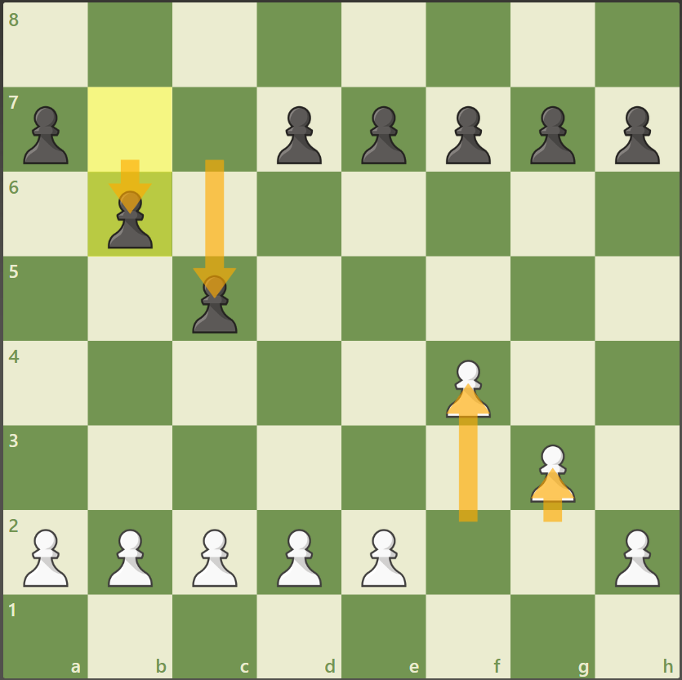
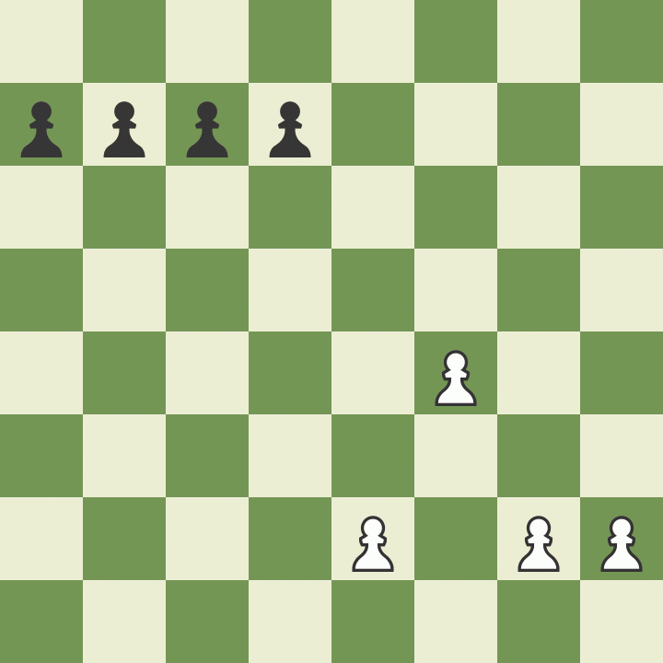
Pawns – 1 Point
Pawns always start on their 2nd Rank
Pawns love to start fast!
  May take 2 spaces forward for their starting move, or
  May just take 1 space to start
  May only move one space at a time after that
  When they reach the back rank they will change to whatever piece they want!

Slide 13
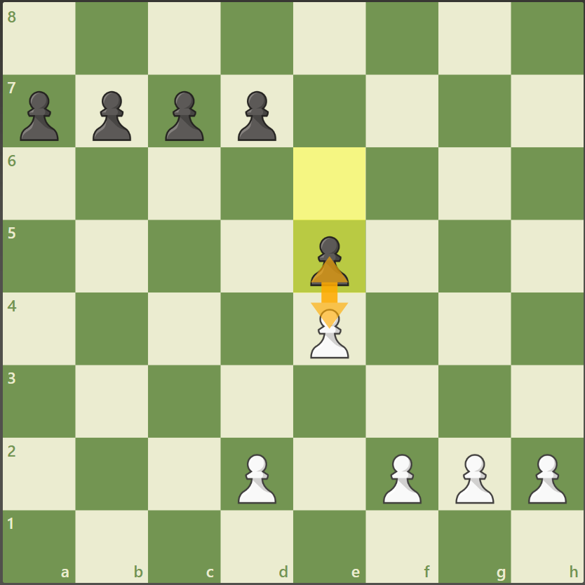
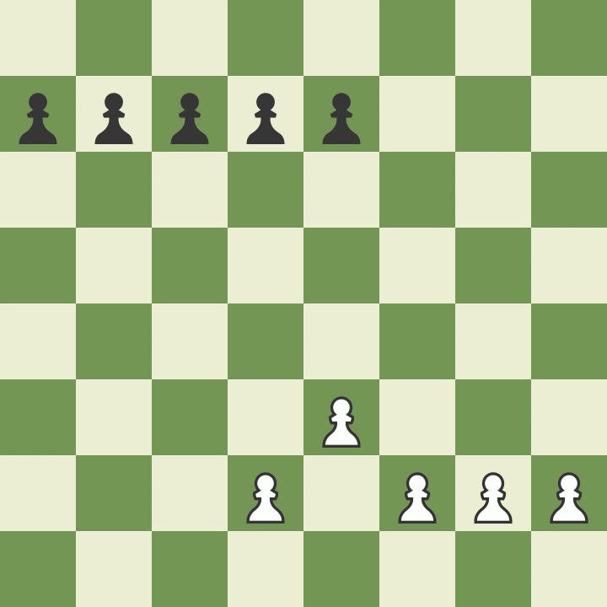
Pawns – 1 Point
Pawns always start on their 2nd Rank
Pawns love to start fast!
Pawns can not move through or over pieces
  If they meet a piece they are stuck!

Slide 14
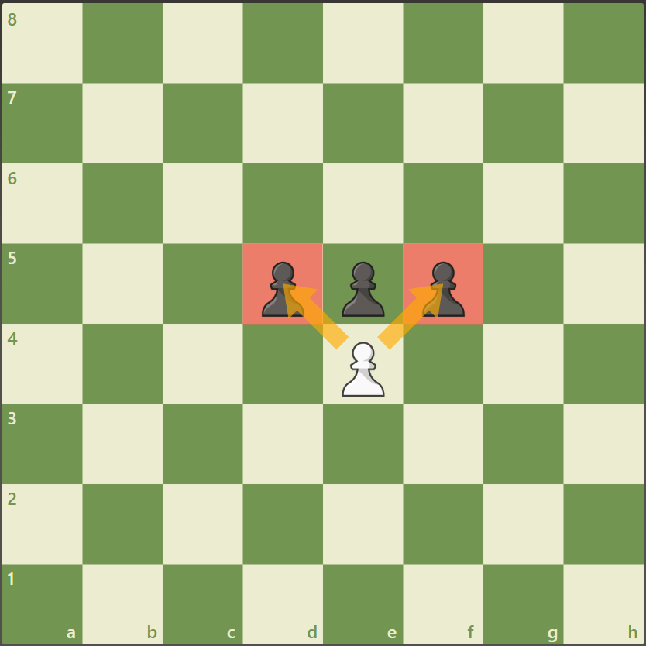
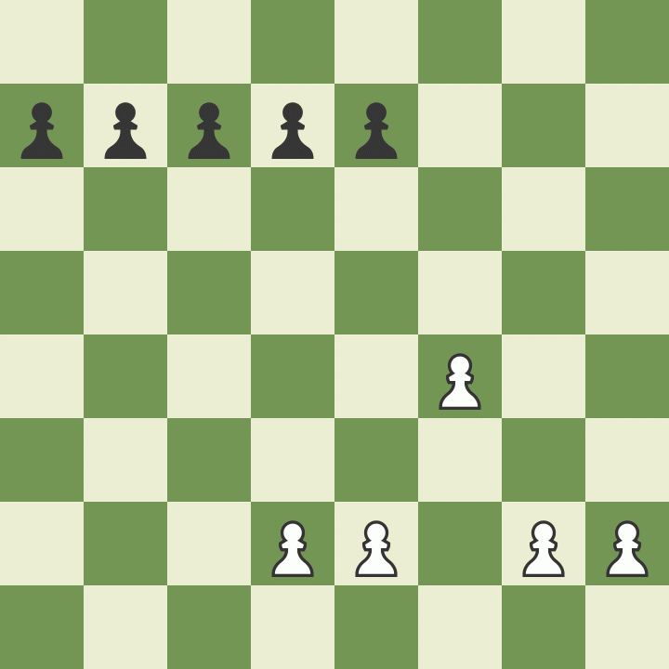
Pawns – 1 Point
Pawns always start on their 2nd Rank
Pawns love to start fast!
Pawns can not move through or over pieces
Pawns capture diagonally
  Must capture diagonally forward

Slide 15
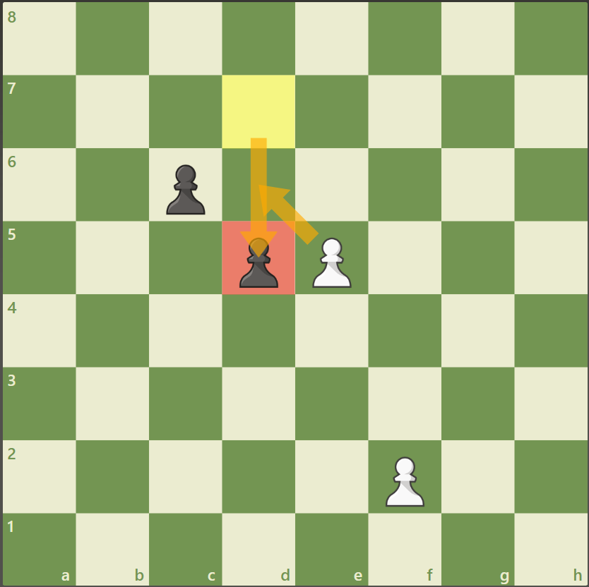
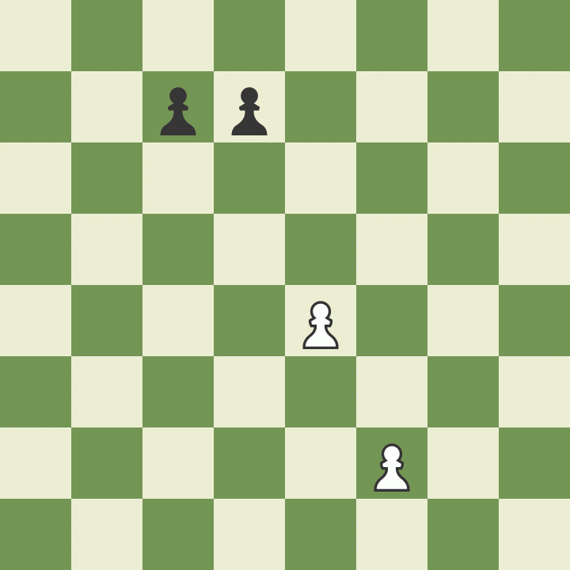
Pawns – 1 Point
Pawns always start on their 2nd Rank
Pawns love to start fast!
Pawns can not move through or over pieces
Pawns capture diagonally
En Passant!
  If you pawn is on the 5th Rank and your opponent tries to zoom past, then you may take by En Passant!

Slide 16
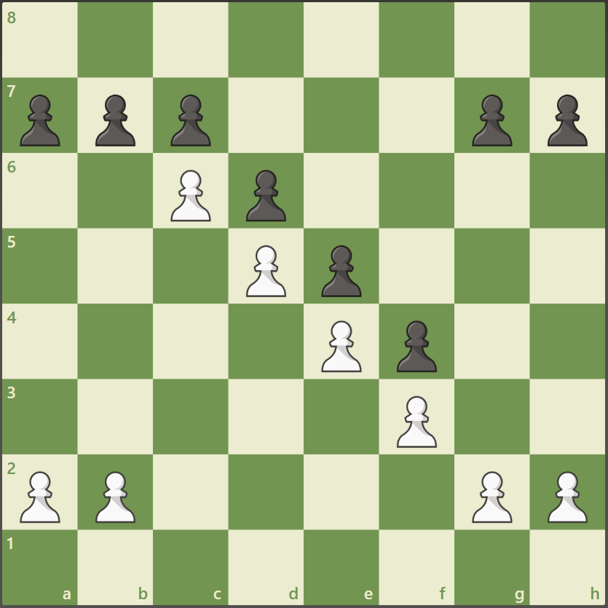
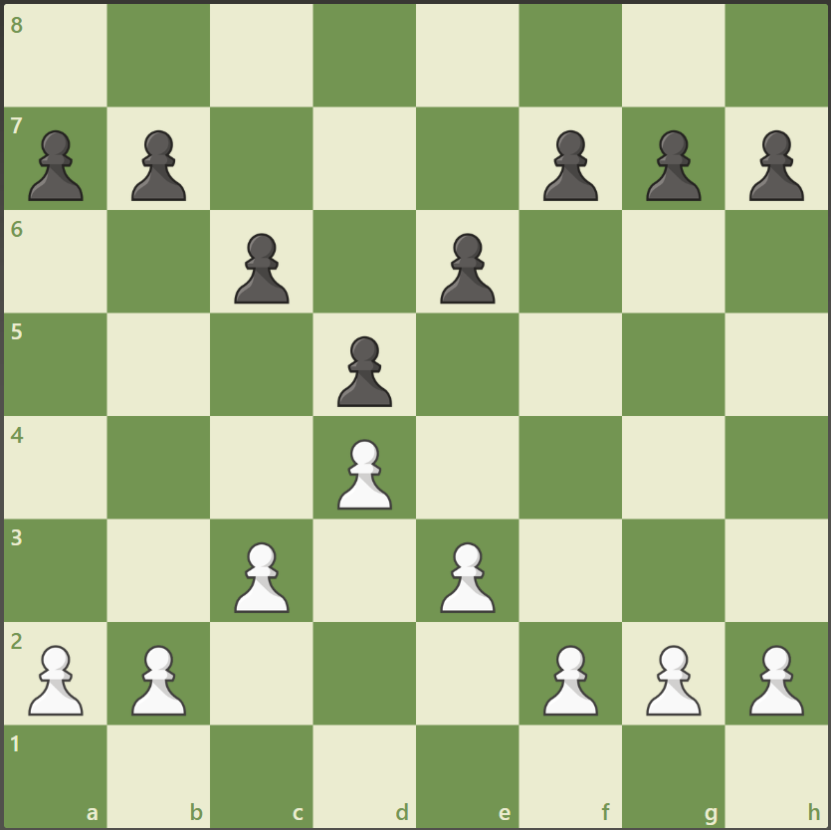
Pawns – 1 Point
Pawns always start on their 2nd Rank
Pawns love to start fast!
Pawns can not move through or over pieces
Pawns capture diagonally
En Passant!
Pawns work well together!
  Always try to make pawn chains, or pyramids
  They are very hard to break apart or through

Slide 17
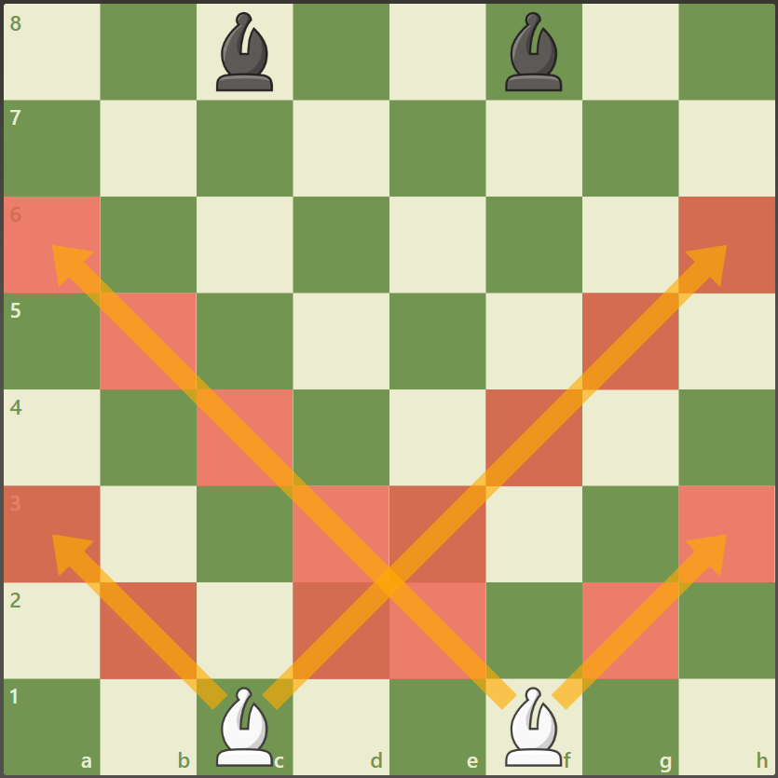
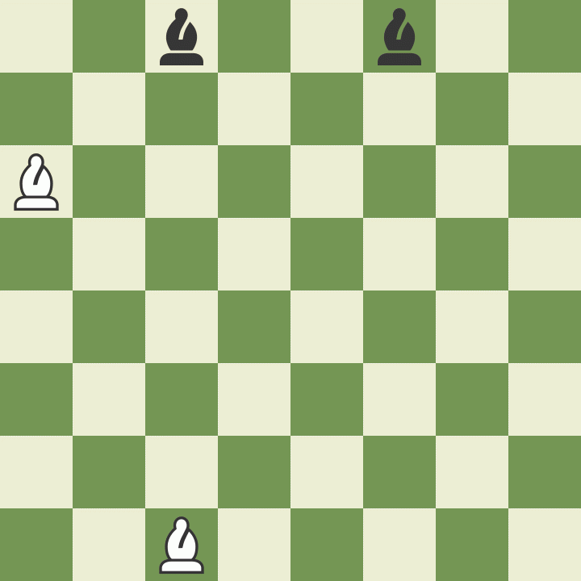
Bishops – 3 Points
Bishops always start on the C and F-files
Bishops move in any number of spaces diagonally
  Bishops can not jump over pieces

Slide 18
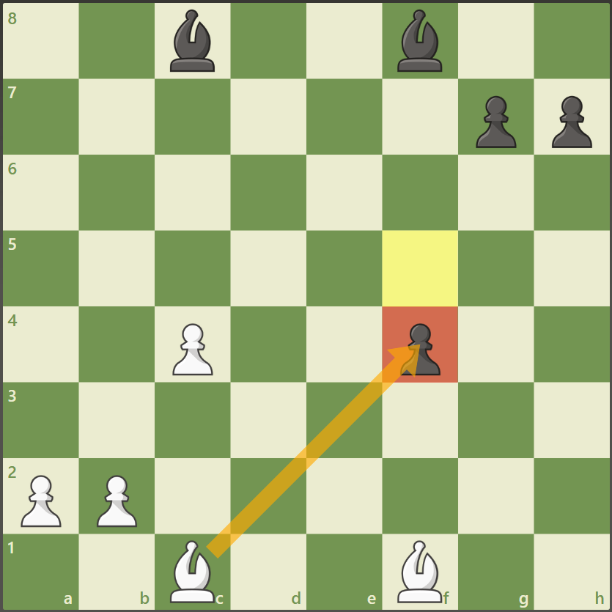
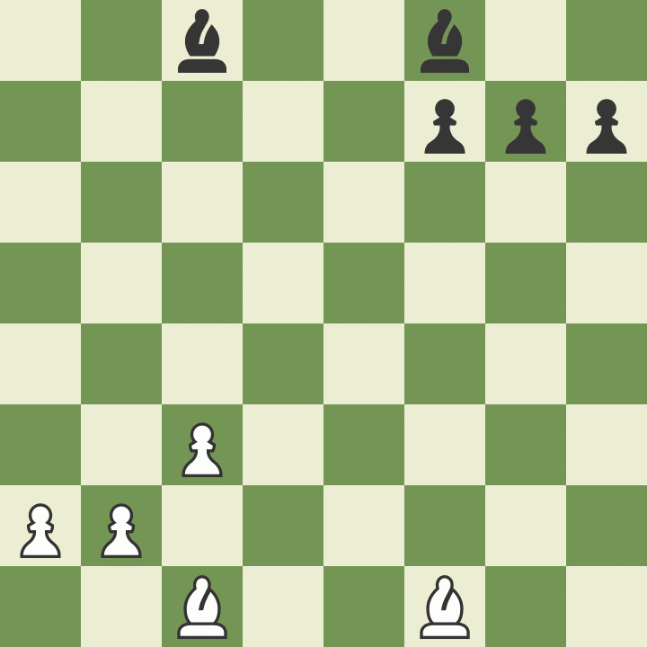
Bishops – 3 Points
Bishop move in any number of spaces diagonally
Bishops capture by landing on a piece

Slide 19
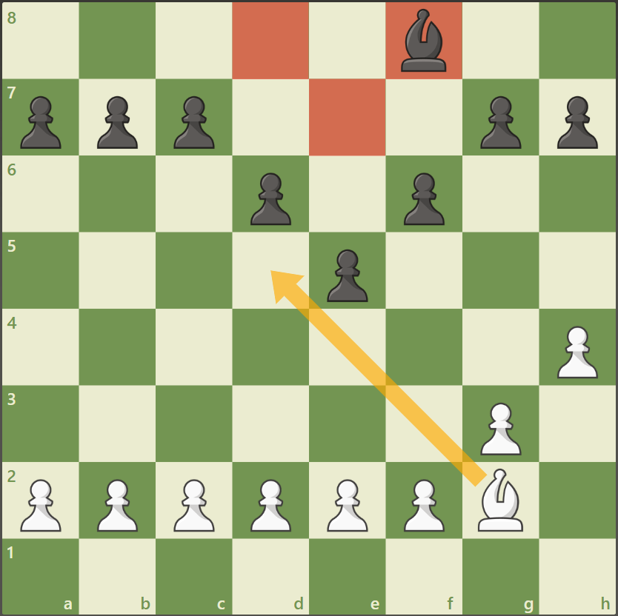
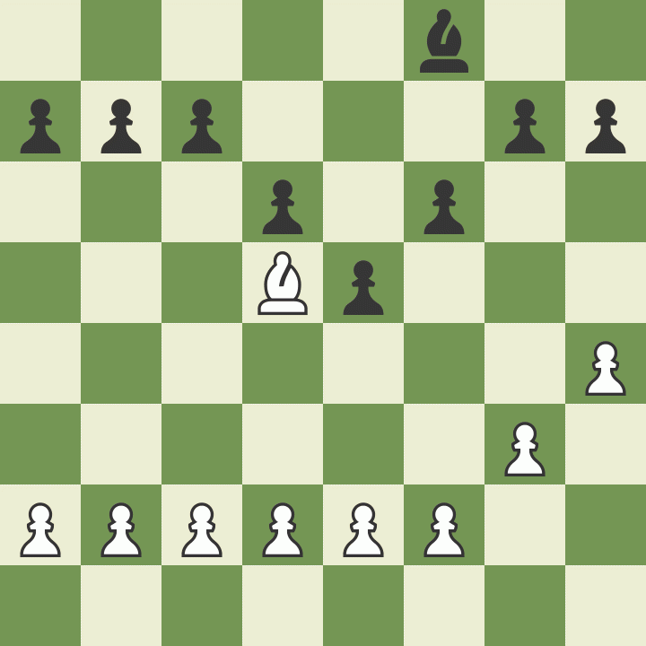
Bishops – 3 Points
Bishop move in any number of spaces diagonally
Bishops capture by landing on a piece
An active bishop is a GOOD bishop!
  An active bishop is outside of their pawns and is the opposite color of its pawns
  We call this a HAPPY Bishop
A trapped bishop is a BAD bishop!
  An active bishop is inside of their pawns and the same color as their pawn structure.
  We call this a SAD Bishop

Slide 20
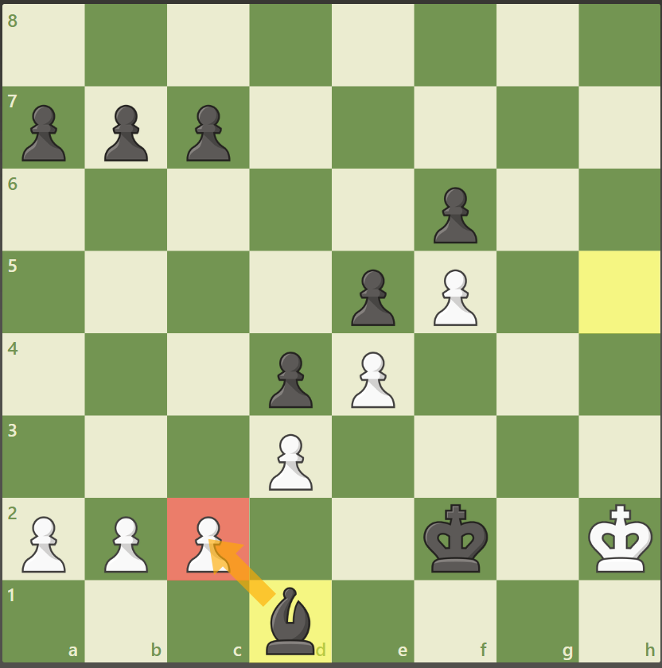
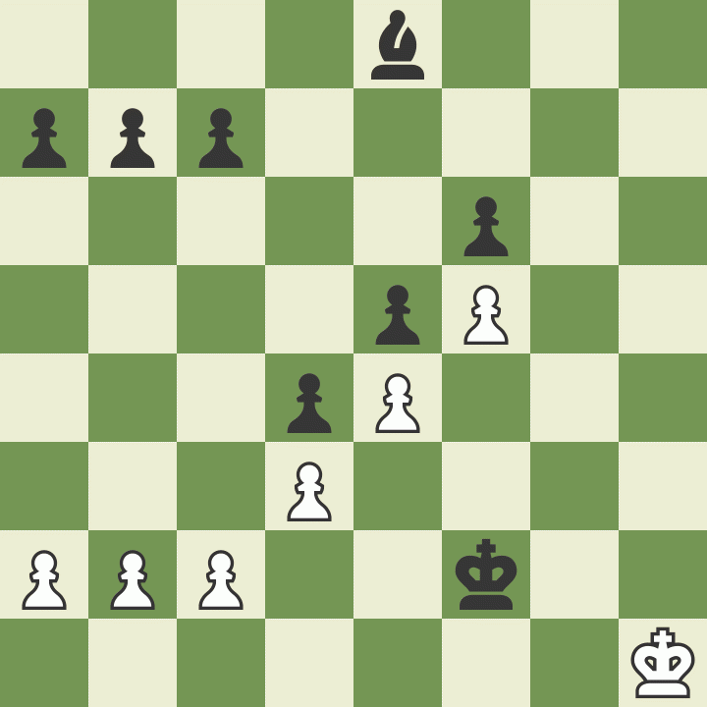
Bishops – 3 Points
Bishop move in any number of spaces diagonally
Bishops capture by landing on a piece
AN active bishop is a GOOD bishop!
A trapped bishop is a BAD bishop!
If a bishop can get to the base of a pawn structure, it can EAT EAT EAT!

Slide 21
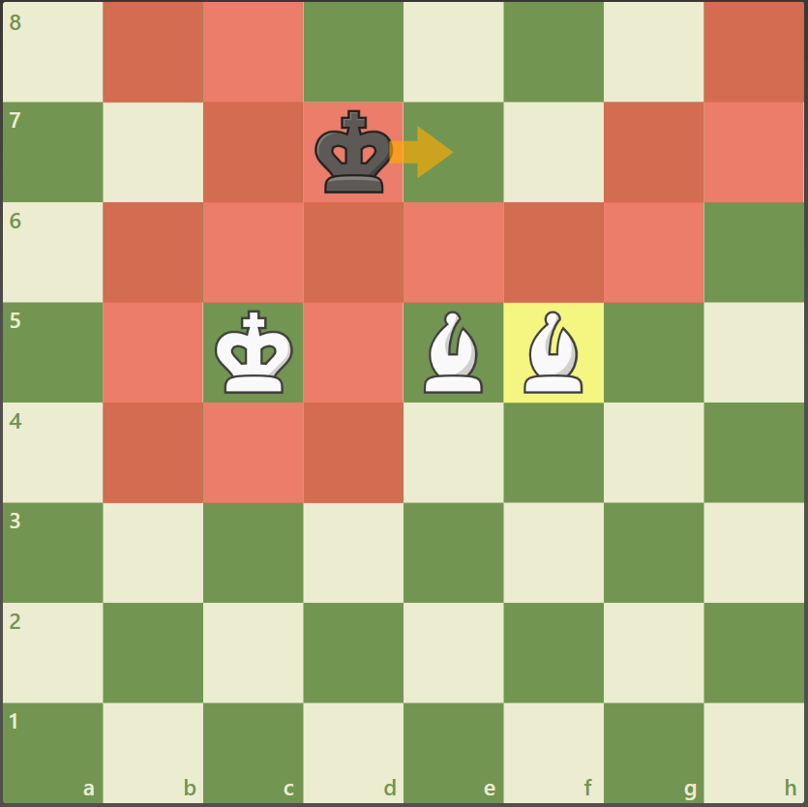
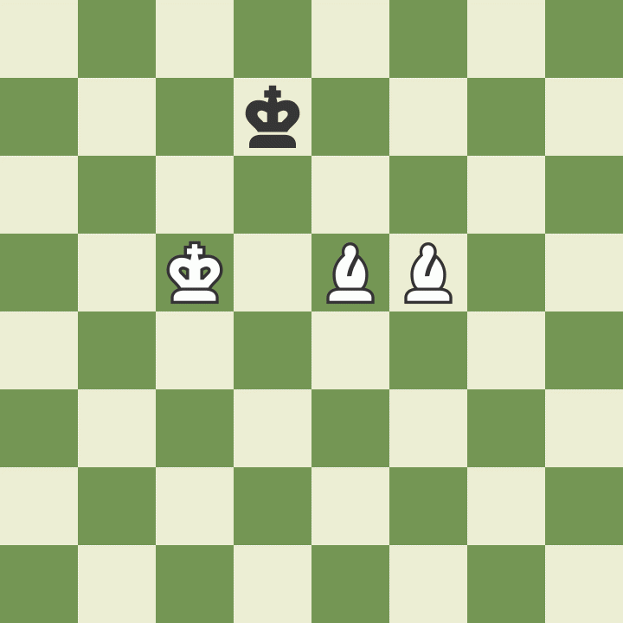
Bishops – 3 Points
Bishop move in any number of spaces diagonally
Bishops capture by landing on a piece
An active bishop is a HAPPY bishop!
An trapped bishop is a SAD bishop!
If a bishop can get to the base of a pawn structure, it can EAT EAT EAT!
Bishop pairs are useful and strong!
  A bishop pair is powerful
  A bishop pair can checkmate the King!

Slide 22
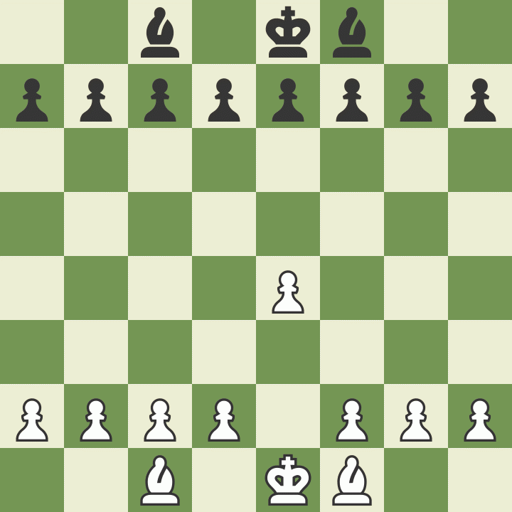
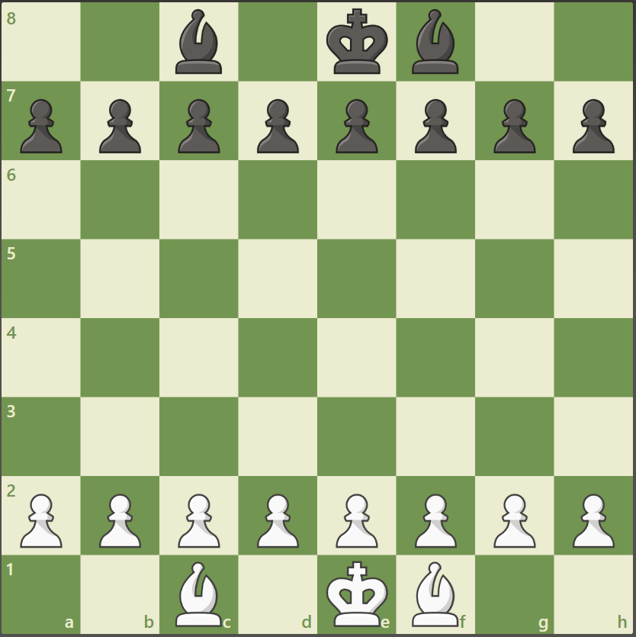
Pawn Game
Try to get a pawn to the 8th rank
Take all of you opponents pieces
Checkmate your opponent

Slide 23
Let’s Play!
Mrs. Ennis
Rusty Charles
Columbiacounty.chess@gmail.com

