Slide 1
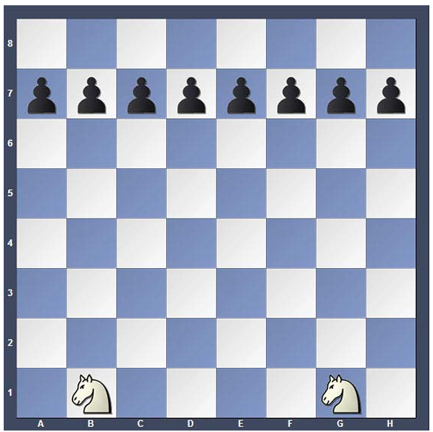
Arrival Activity
Knight versus Pawns
The player with the Knight attempts to capture as many pawns as possible
Once a Pawn reaches the final rank it is frozen and cannot be captured
After no possible pawn moves remain, players switch colors

Slide 2


Welcome to the Stevens Creek Elementary Chess Club!
Mrs. Ennis
Rusty Charles
Columbia County Chess Association

Slide 3



STCE Chess Club –
Rules and Expectations
Etiquette
  Always be respectful
  Do not argue with your opponent
    Call a teacher over if there is a problem
  Do not throw or be sloppy with pieces
    All pieces should stay on the table
  We are here to learn and have fun

Slide 4
STCE Chess Club – Session 4
Review
  Point Values of pieces
  Pawns
  Bishop
Knights
  Hippity-Hippity-Hop
  Outposts / Homes
Queen
  Movements
  Good vs. Bad Bishops
  Bishop pairs
Pawn Games

Slide 5






Piece Values
It is important to know that some pieces are considered more valuable than others. This helps us understand and calculate exchanges.
King – Infinite!
Bishop – 3 Points
Queen – 9 Points
Knight – 3 Points
Rook – 5 Points
Pawn – 1 Point

Slide 6
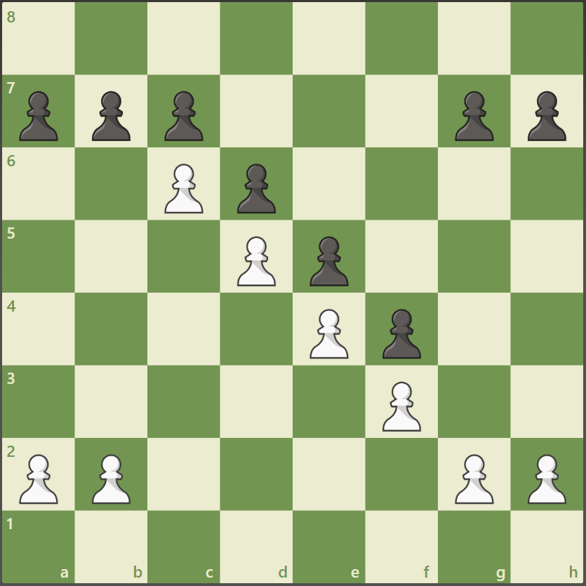
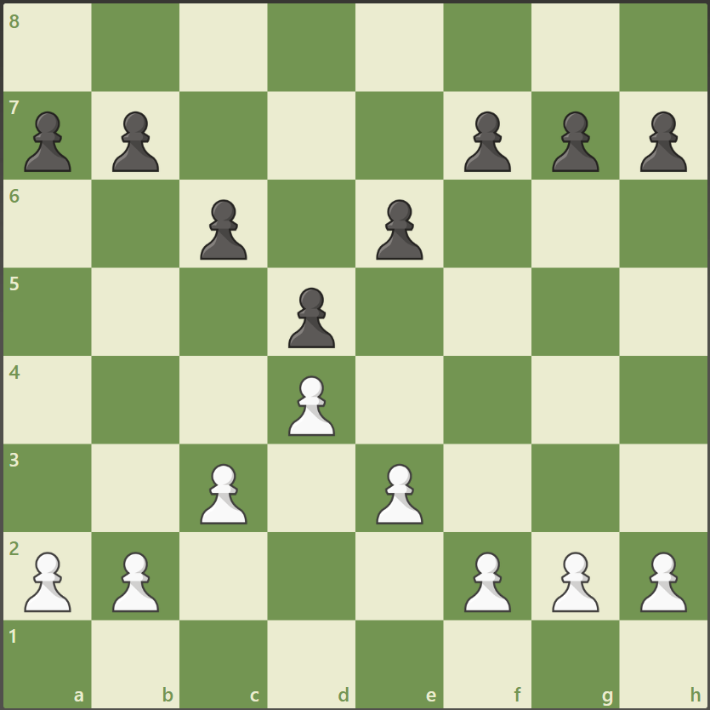
Pawns – 1 Point
Pawns always start on their 2nd Rank
Pawns love to start fast!
Pawns can not move through or over pieces
Pawns capture diagonally
En Passant!
Pawns work well together!
  Always try to make pawn chains, or pyramids
  They are very hard to break apart or through

Slide 7
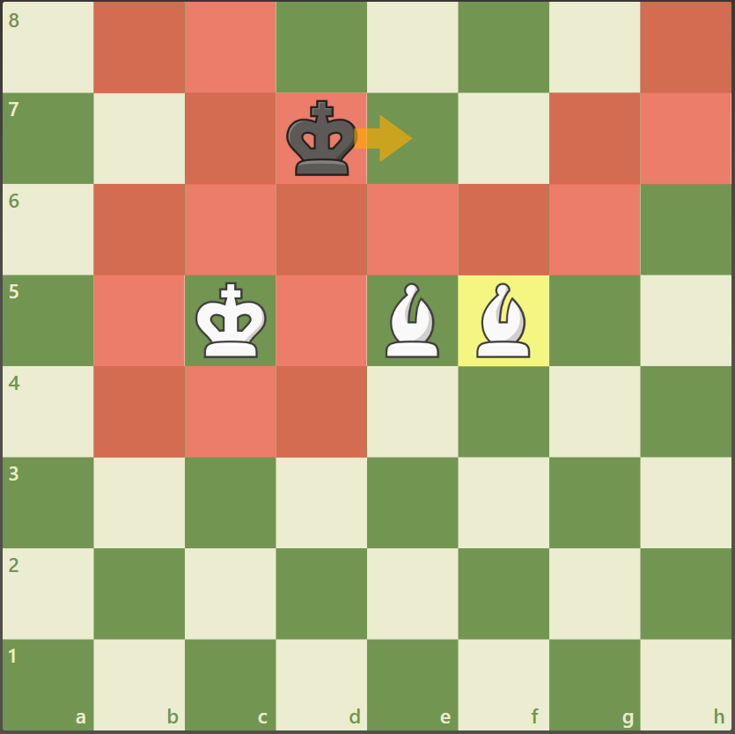
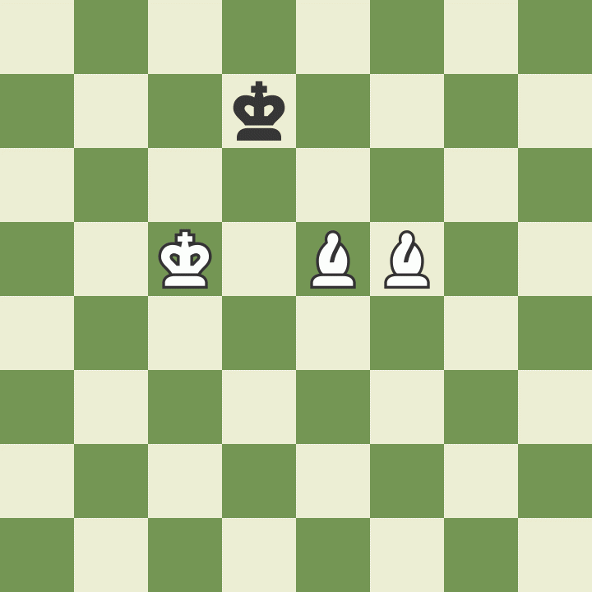
Bishops – 3 Points
Bishop move in any number of spaces diagonally
Bishops capture by landing on a piece
An active bishop is a HAPPY bishop!
An trapped bishop is a SAD bishop!
If a bishop can get to the base of a pawn structure, it can EAT EAT EAT!
Bishop pairs are useful and strong!
  A bishop pair is powerful
  A bishop pair can checkmate the King!

Slide 8

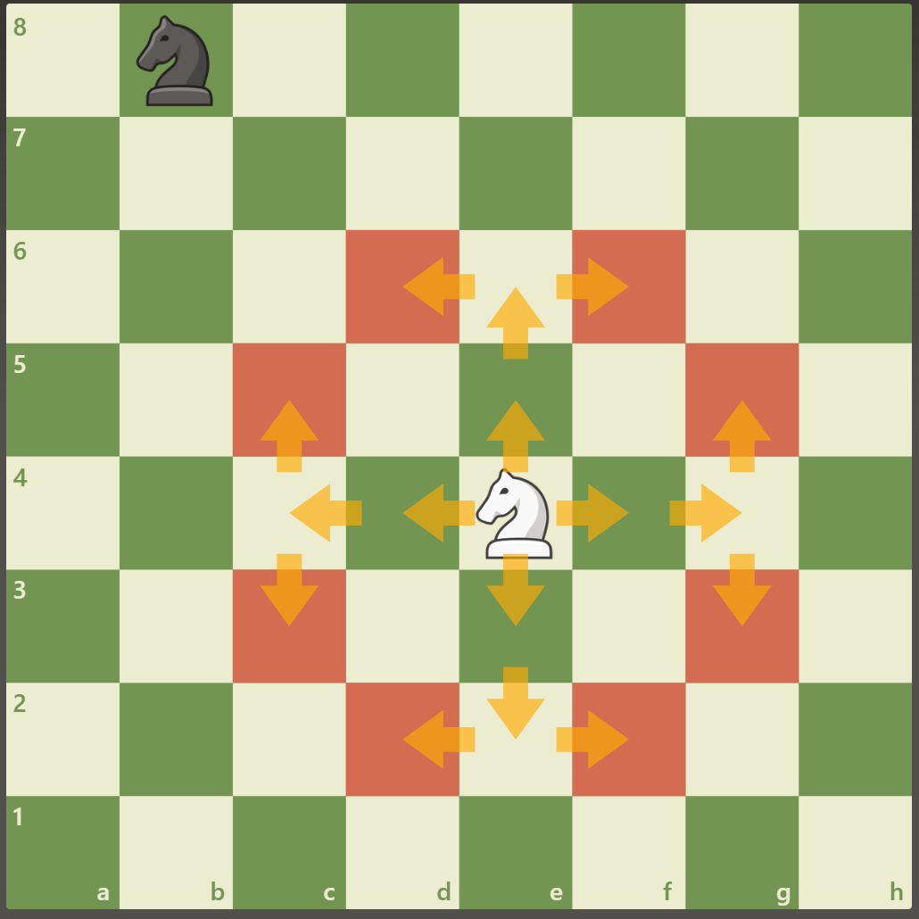
Knights – 3 Points
Knights are tricky
Knights move in an L-Shape
  Two spaces in one direction, 1 space in the sideways direction
  Hippity-Hippity-Hop

Slide 9
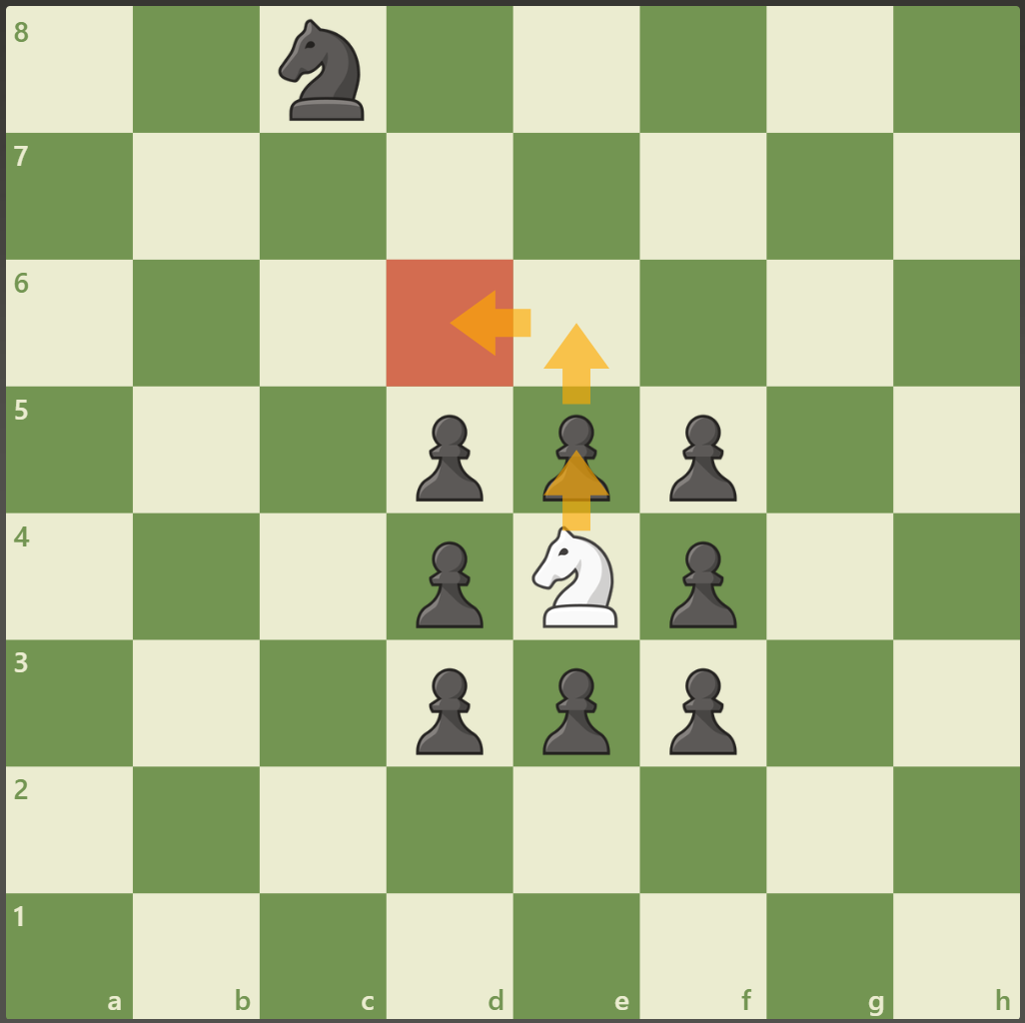
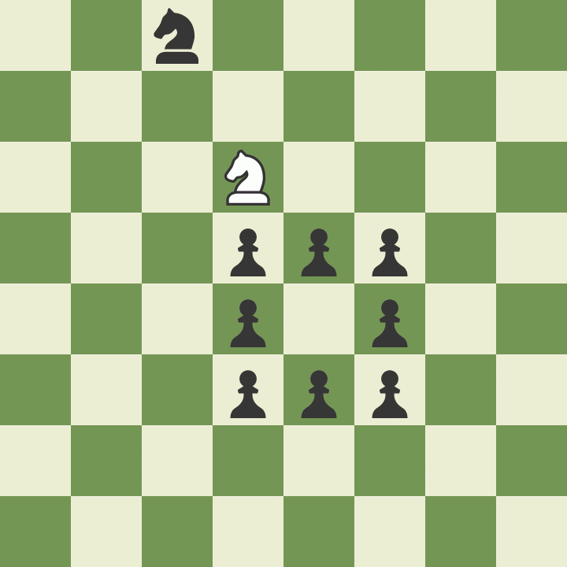
Knights – 3 Points
Knights are tricky
Knights move in an L-Shape
  Two spaces in one direction, 1 space in the sideways direction
  Hippity-Hippity-Hop
Knights can jump over pieces

Slide 10
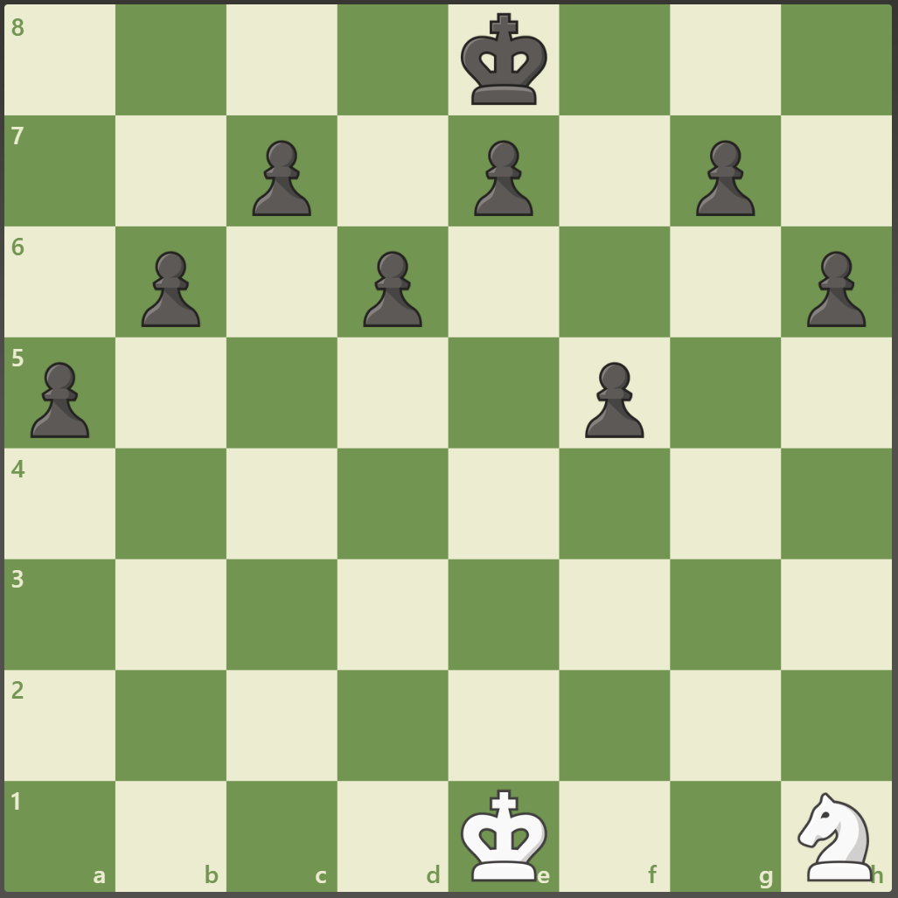
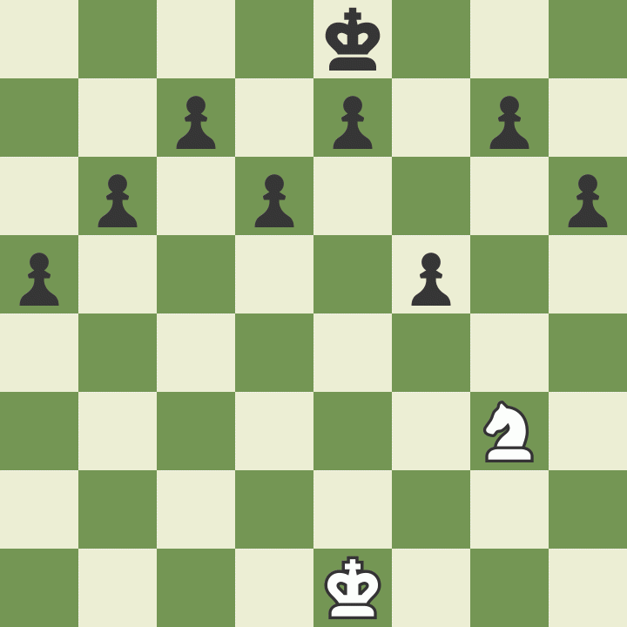
Knights – 3 Points
Knights are tricky
Knights move in an L-Shape
  Two spaces in one direction, 1 space in the sideways direction
  Hippity-Hippity-Hop
Knights can jump over pieces
Knights capture pieces by landing on them

Slide 11
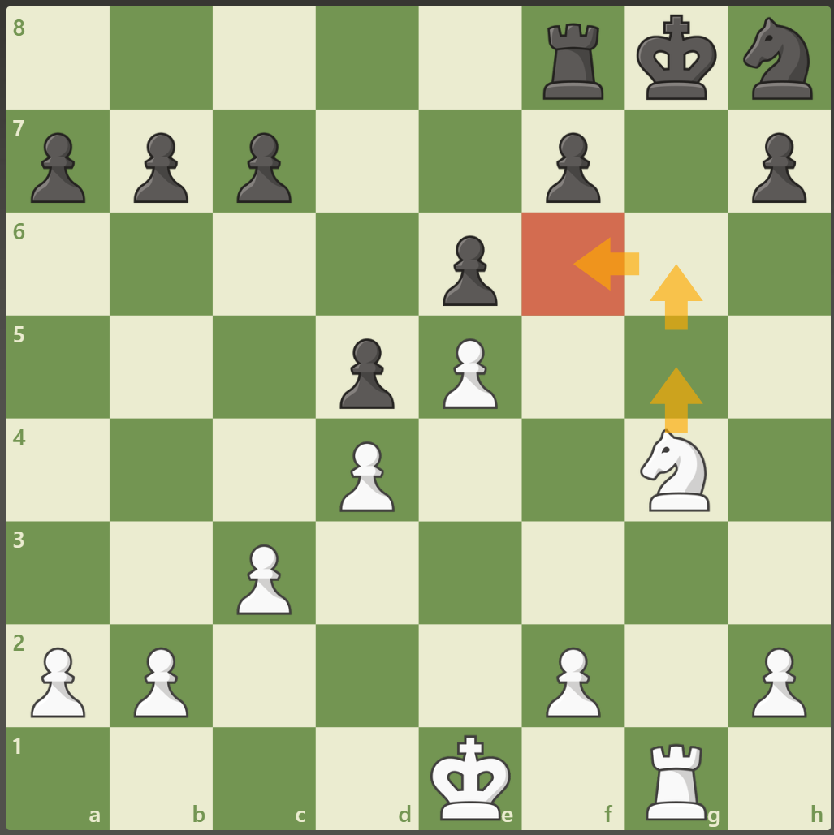
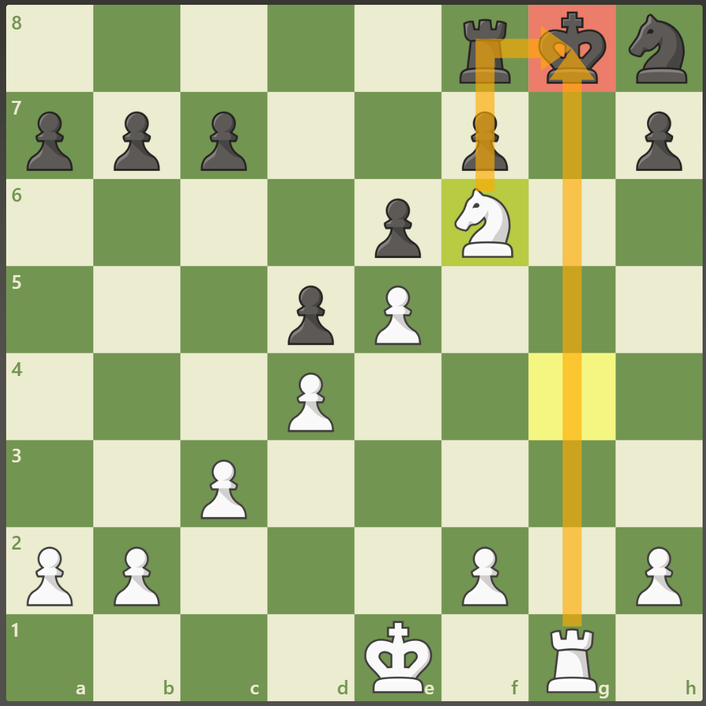
Knights – 3 Points
Knights are tricky
Knights move in an L-Shape
  Two spaces in one direction, 1 space in the sideways direction
  Hippity-Hippity-Hop
Knights can jump over pieces
Knights capture pieces by landing on them
Knights like to find a safe home!
  Find an Outpost

Slide 12

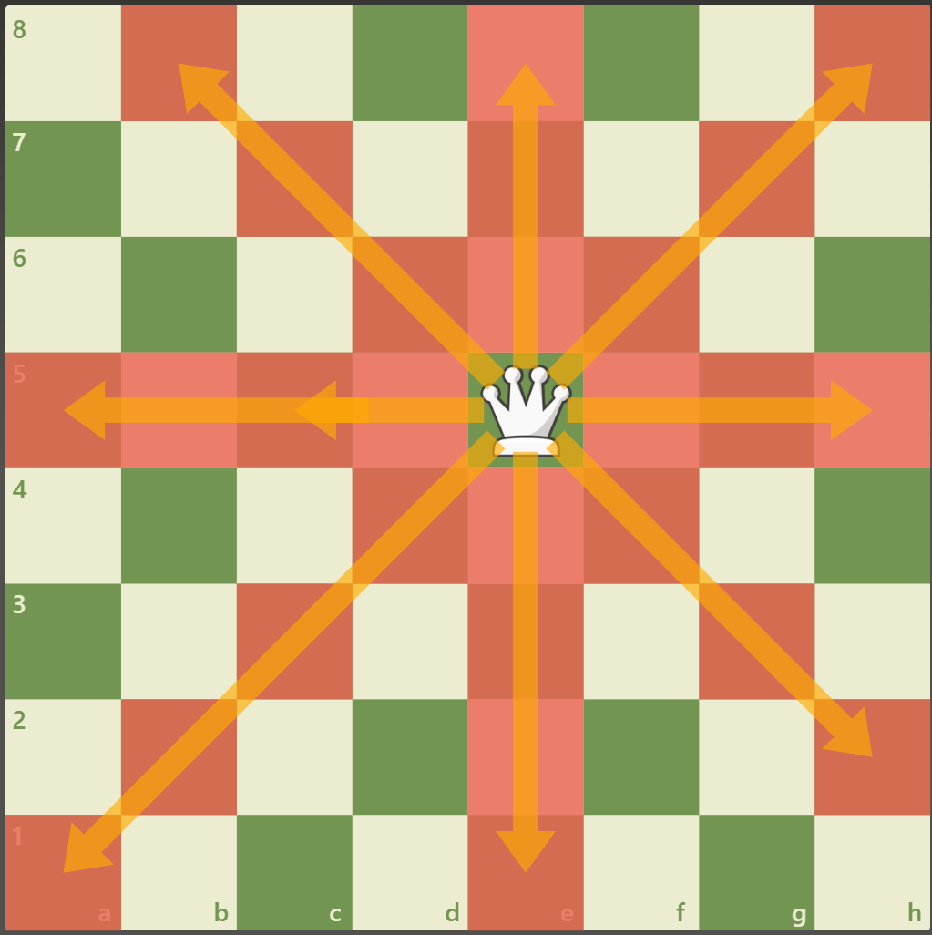
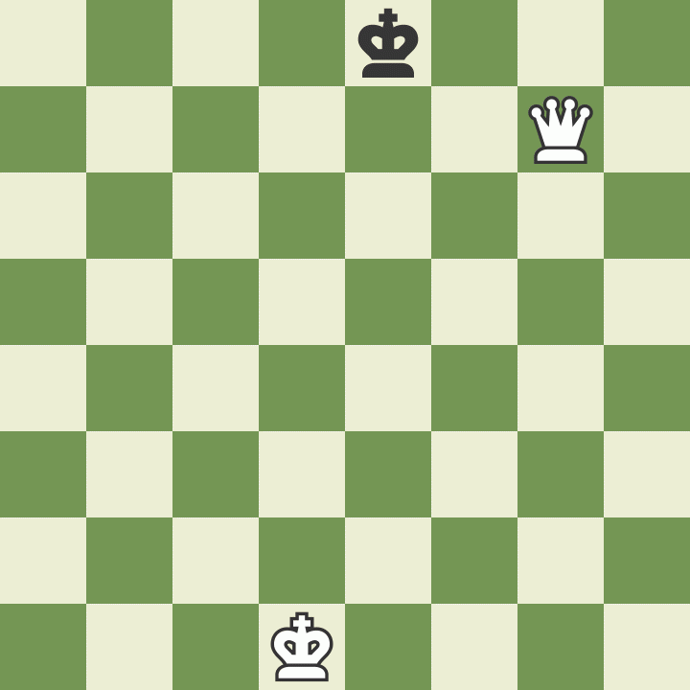
Queen – 9 Points
Queens move in any direction as many spaces as it can without going through a pieces
  Queens move like Rooks AND
  Queens move like Bishops
Queens can not run through other pieces

Slide 13
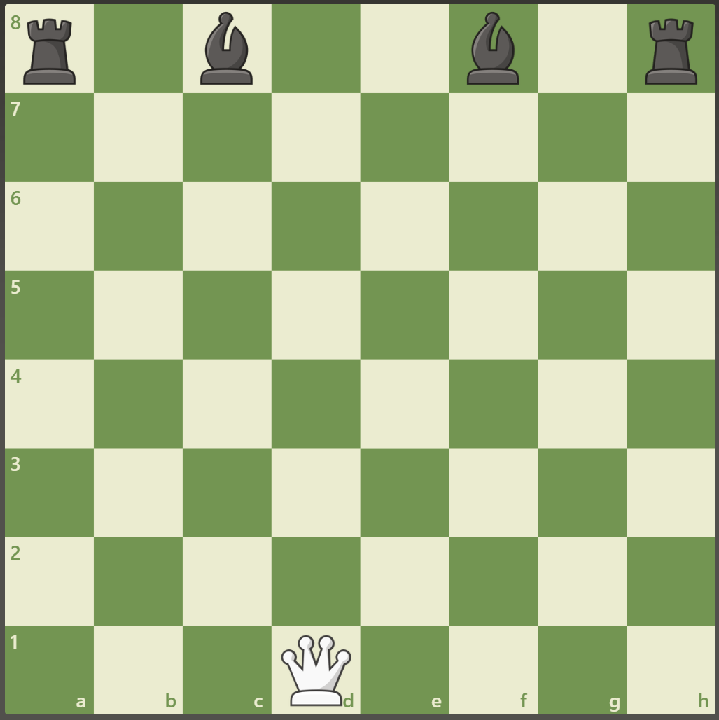
Queen Game
Three ways to win
Practice the piece movements
Try to take all you opponent's pieces

Slide 14
Let’s Play!
Mrs. Ennis
Rusty Charles
Columbiacounty.chess@gmail.com

