Slide 1
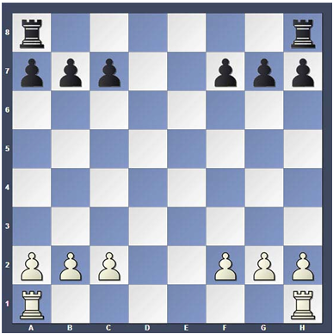
Arrival Activity
Rooks and Pawns
Play a game with a partial team to focus on the Rook and Pawn movements
Captures all of his / her opponents pieces first to win
GOAL – Practice basic Rook strategy and technique

Slide 2


Welcome to the Stevens Creek Elementary Chess Club!
Mrs. Ennis
Rusty Charles
Columbia County Chess Association

Slide 3



STCE Chess Club –
Rules and Expectations
Etiquette
  Always be respectful
  Do not argue with your opponent
    Call a teacher over if there is a problem
  Do not throw or be sloppy with pieces
    All pieces should stay on the table
  We are here to learn and have fun
Consequences
  Yellow Card
  Red Card

Slide 4
STCE Chess Club – Session 4
Review
Rooks
Kings
Castling

Slide 5






Piece Values
It is important to know that some pieces are considered more valuable than others. This helps us understand and calculate exchanges.
King – Infinite!
Bishop – 3 Points
Queen – 9 Points
Knight – 3 Points
Rook – 5 Points
Pawn – 1 Point

Slide 6
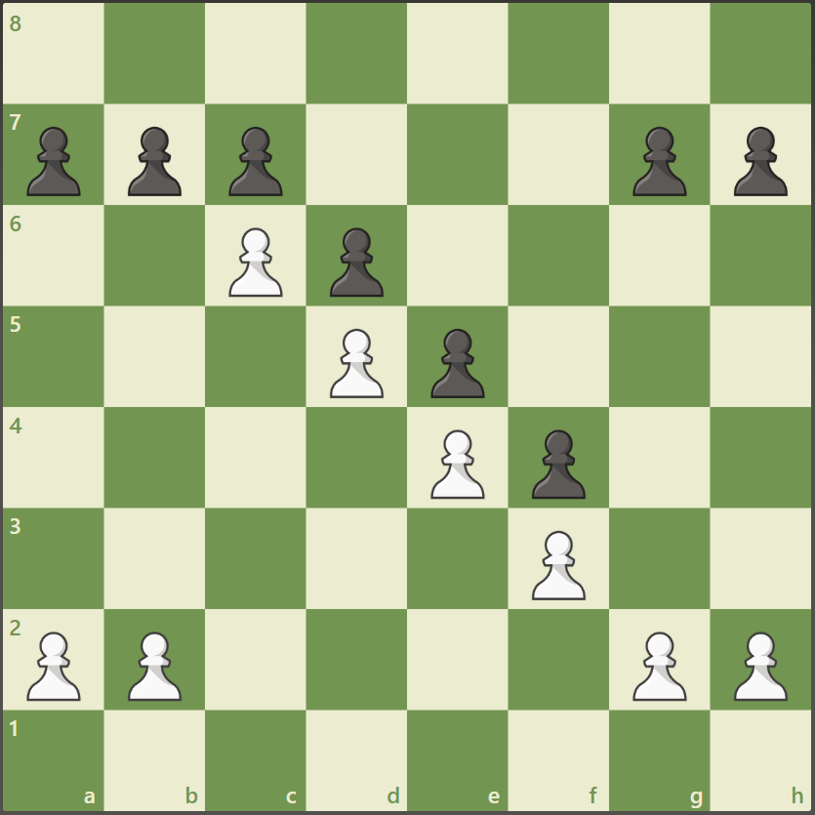
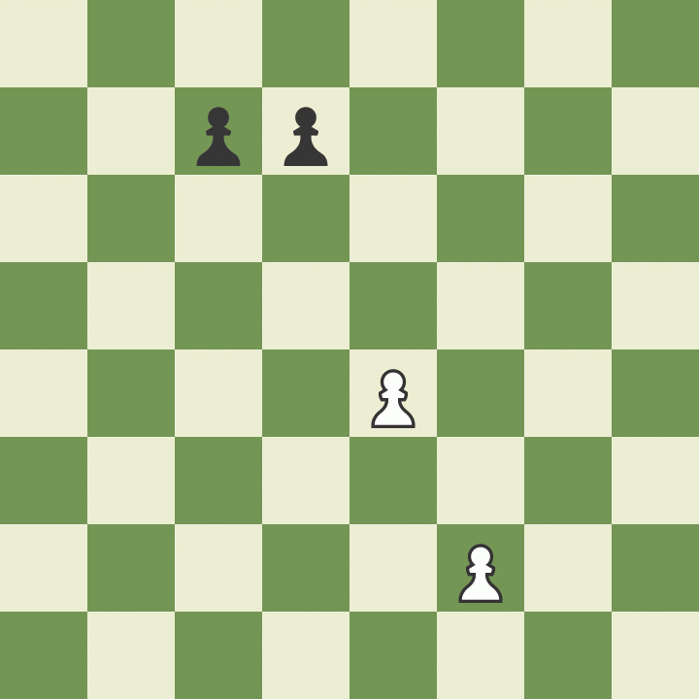
Pawns – 1 Point
Pawns always start on their 2nd Rank
Pawns love to start fast!
Pawns can not move through or over pieces
Pawns capture diagonally
En Passant!
Pawns work well together!
  Always try to make pawn chains, or pyramids
  They are very hard to break apart or through

Slide 7
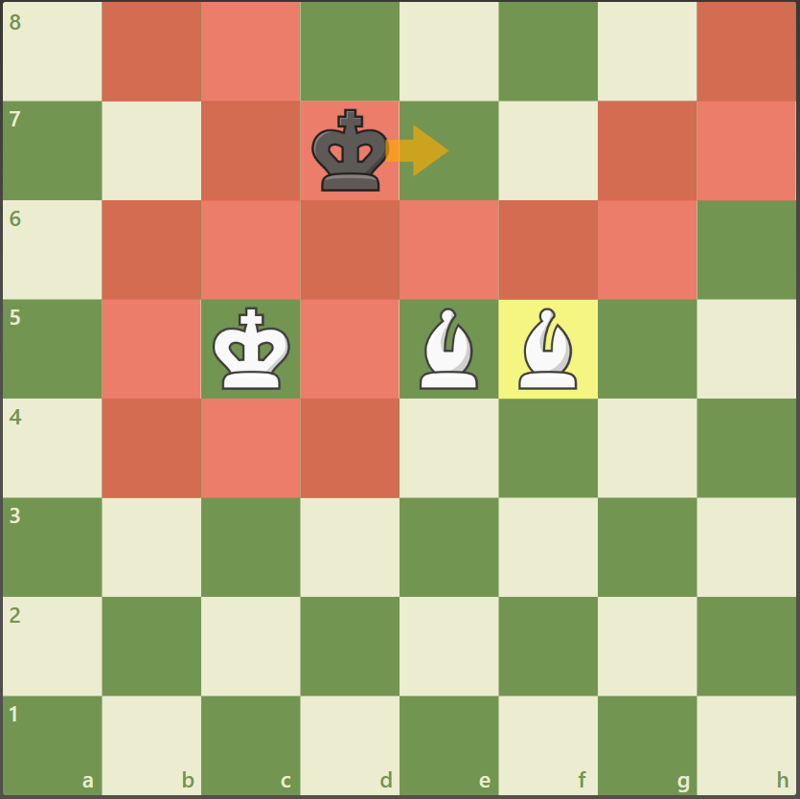
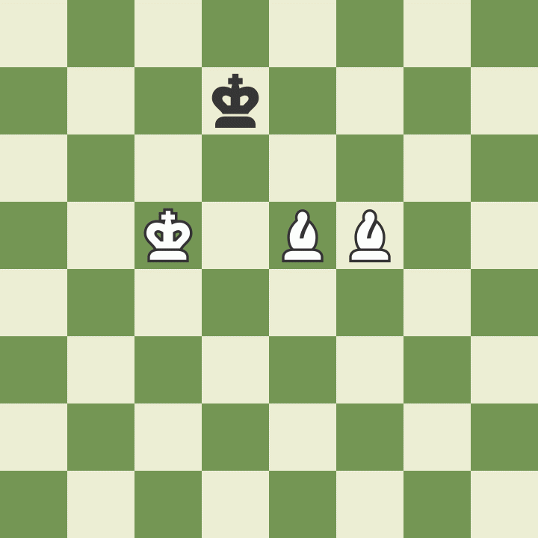
Bishops – 3 Points
Bishop move in any number of spaces diagonally
Bishops capture by landing on a piece
An active bishop is a HAPPY bishop!
An trapped bishop is a SAD bishop!
If a bishop can get to the base of a pawn structure, it can EAT EAT EAT!
Bishop pairs are useful and strong!
  A bishop pair is powerful
  A bishop pair can checkmate the King!

Slide 8

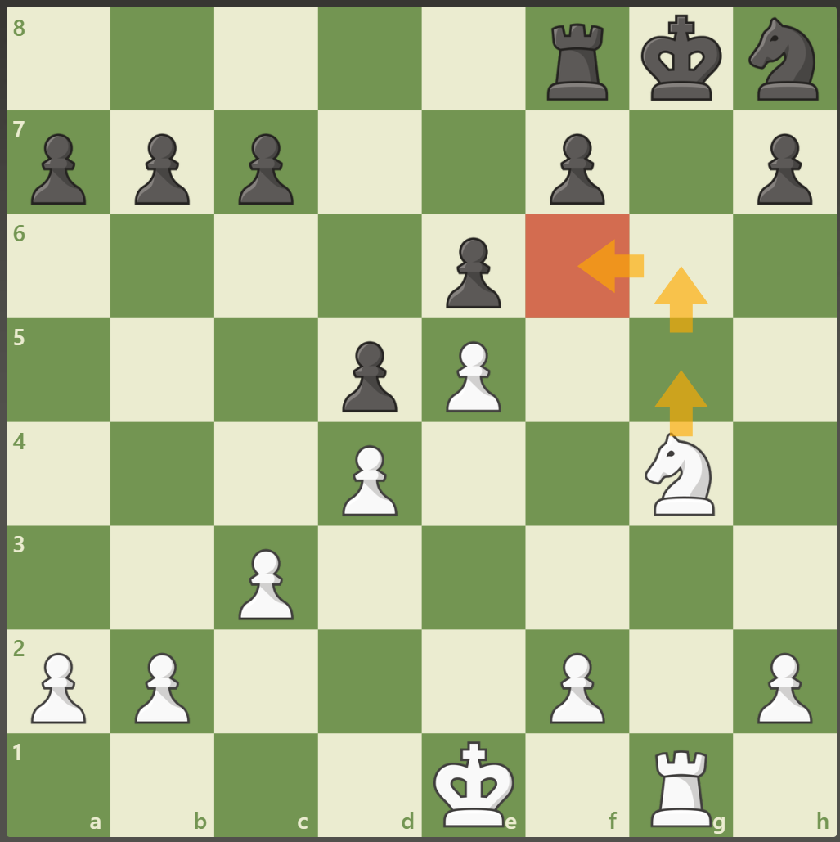
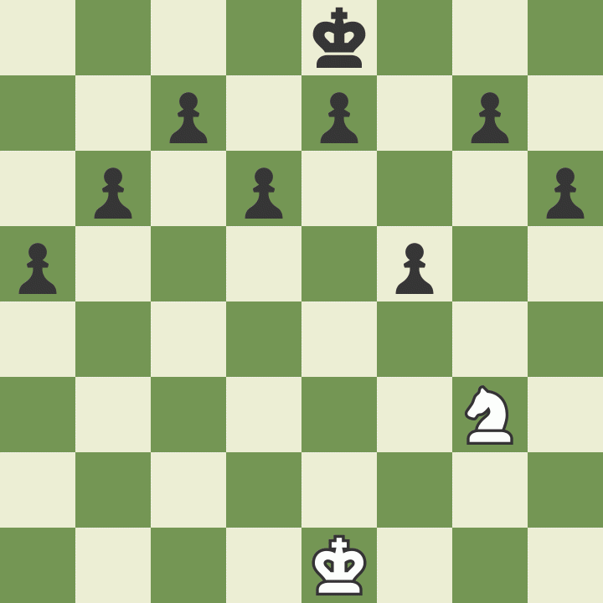
Knights – 3 Points
Knights are tricky
Knights move in an L-Shape
  Two spaces in one direction, 1 space in the sideways direction
  Hippity-Hippity-Hop
Knights can jump over pieces
Knights capture pieces by landing on them
Knights like to find a safe home!
  Find an Outpost

Slide 9

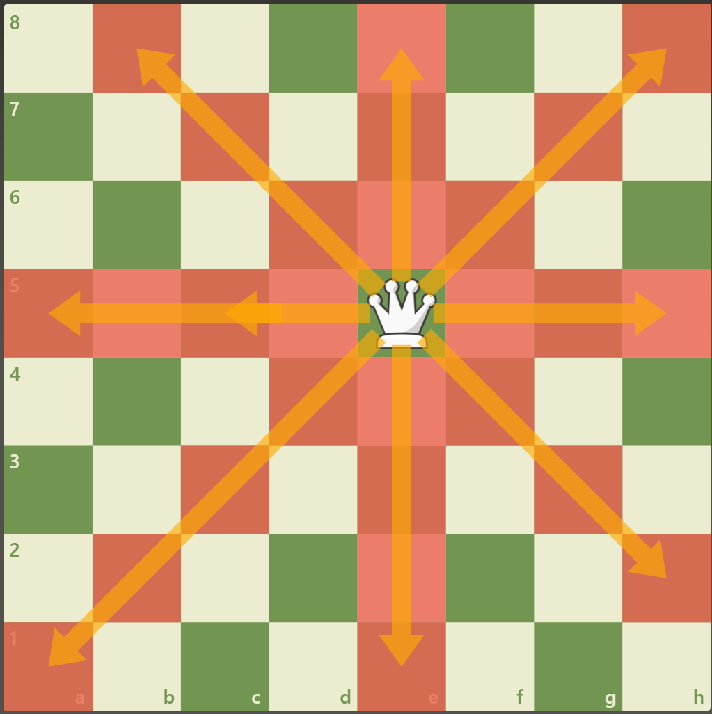
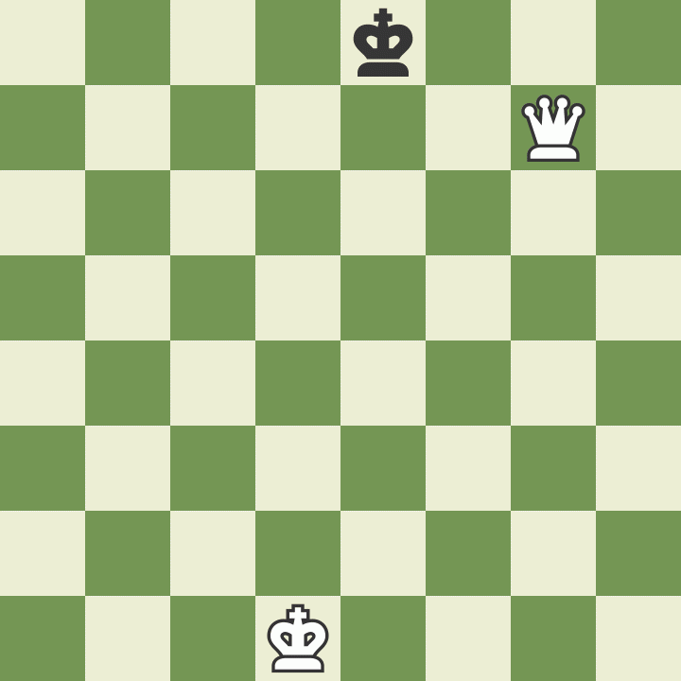
Queen – 9 Points
Queens move in any direction as many spaces as it can without going through a pieces
  Queens move like Rooks AND
  Queens move like Bishops
Queens can not run through other pieces

Slide 10
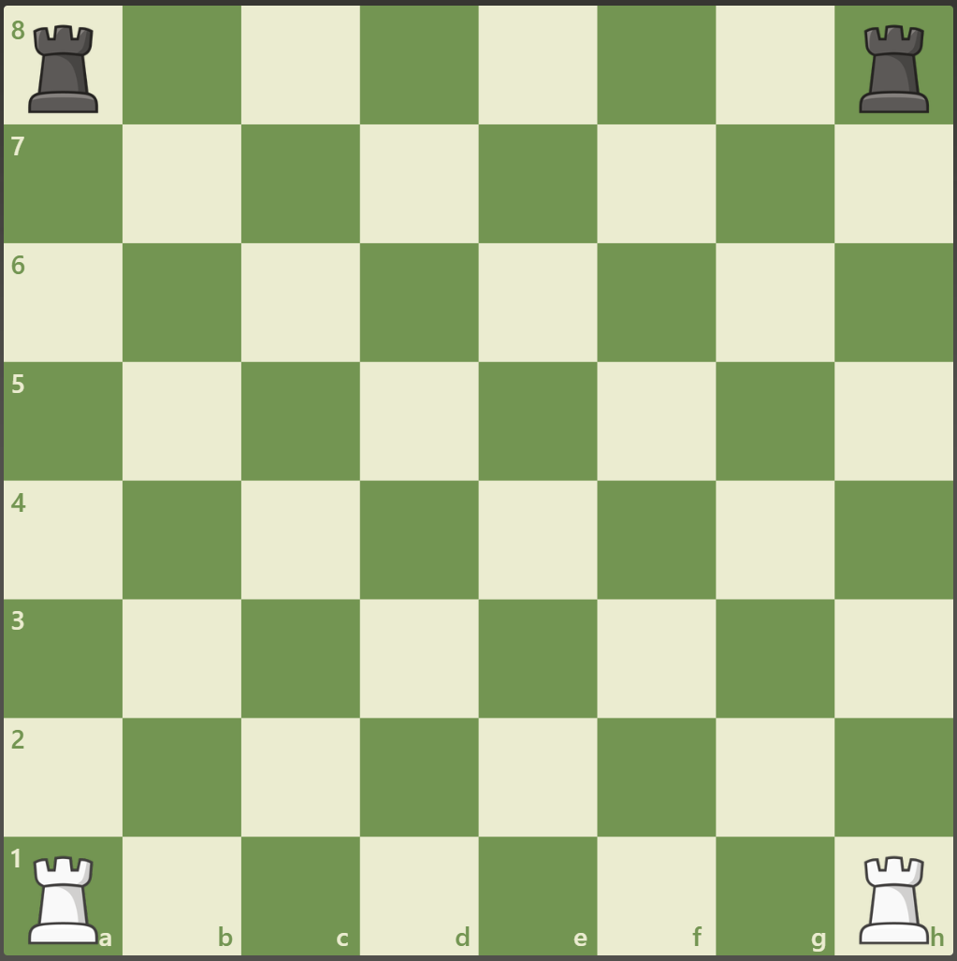
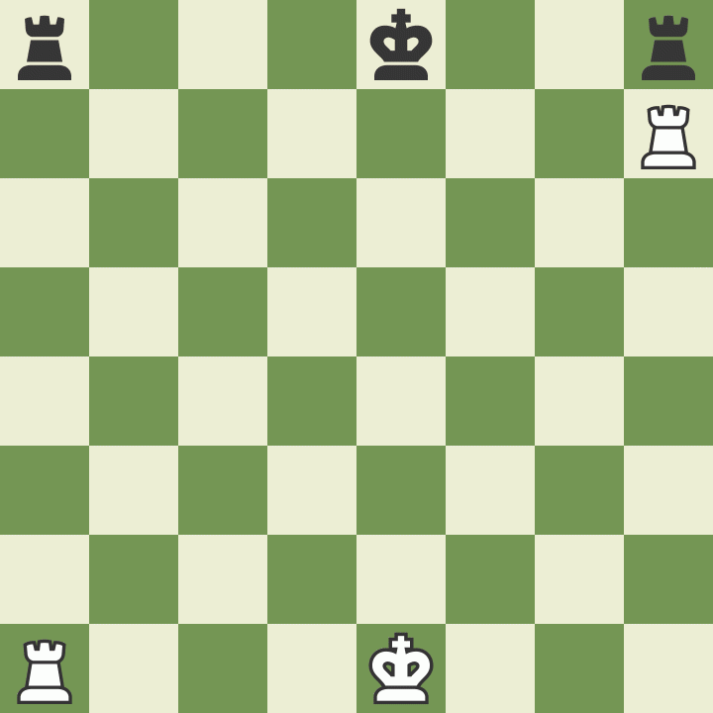
Rooks – 5 Points
Rooks always start in the corners of the board
  The a- and h- files
Rooks move in a straight line until they reach a piece, of the edge of the board
  Up or Down
  Left of right

Slide 11
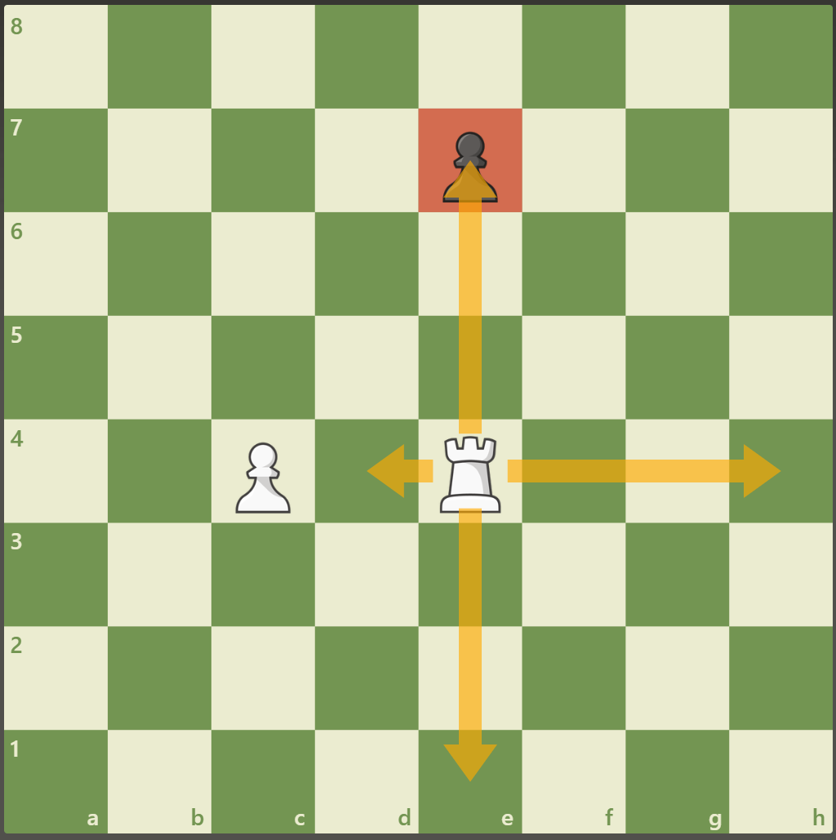
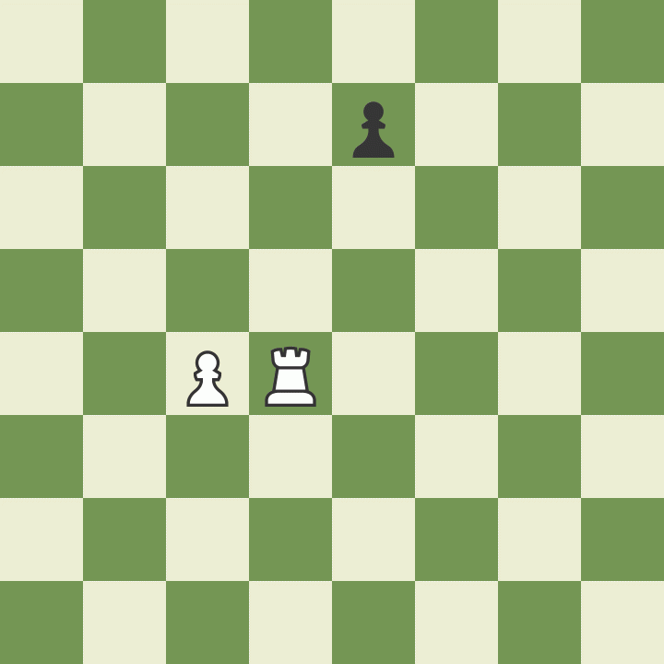
Rooks – 5 Points
Rooks always start in the corners of the board
Rooks move in a straight line until they reach a piece, of the edge of the board
Rooks can move as far as they can see!
  Must stop when they capture a piece

Slide 12
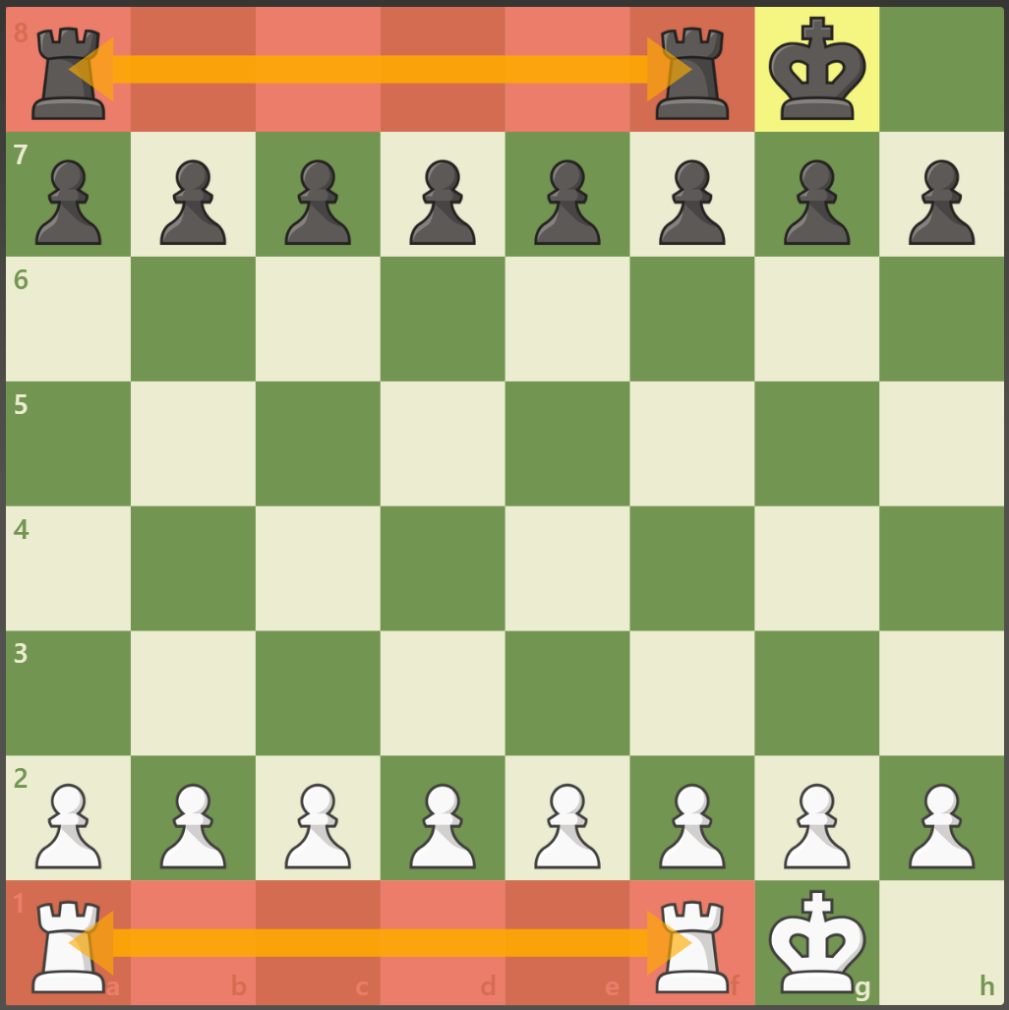
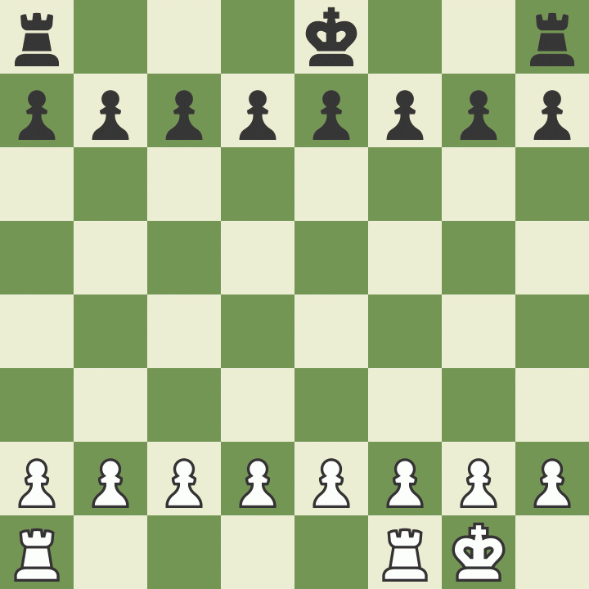
Rooks – 5 Points
Rooks always start in the corners of the board
Rooks move in a straight line until they reach a piece, of the edge of the board
Rooks can move as far as they can see!
Connect your rooks to utilize them better
Open files so that the rooks can “see”

Slide 13
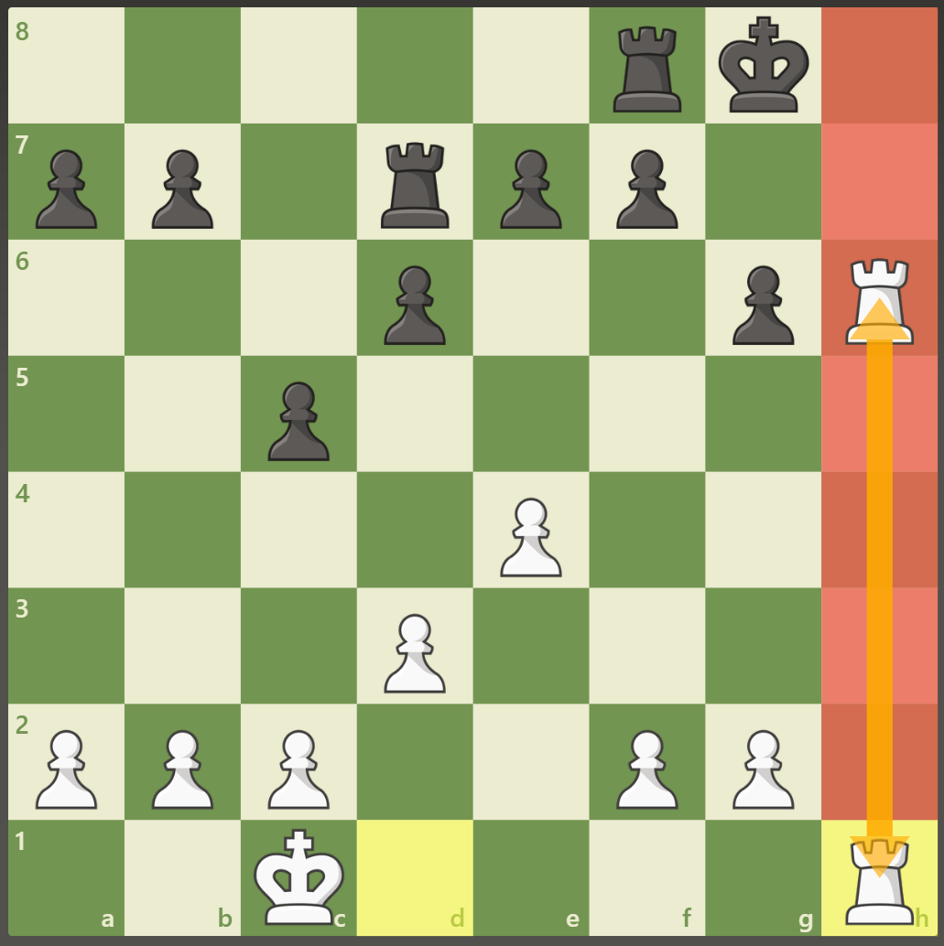
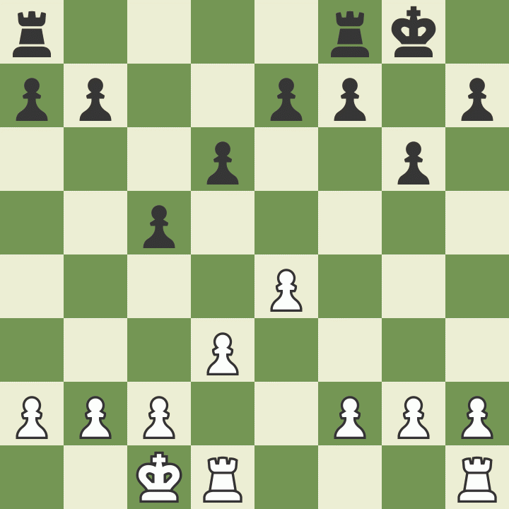
Rooks – 5 Points
Rooks always start in the corners of the board
Rooks move in a straight line until they reach a piece, of the edge of the board
Rooks can move as far as they can see!
Connect your rooks to utilize them better
Open files so that the rooks can “see”
Trade pawns to open files

Slide 14
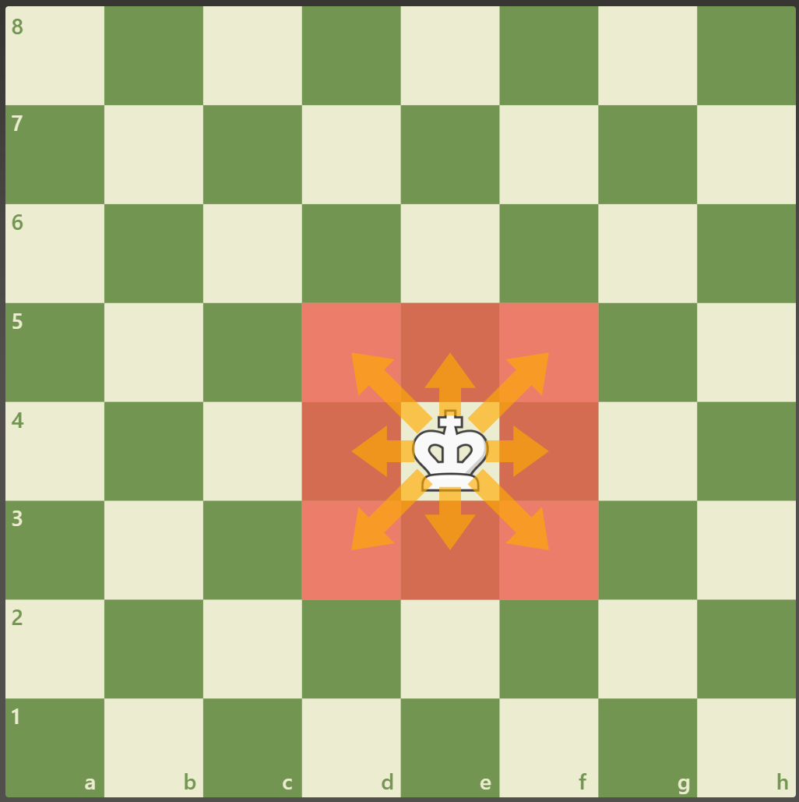
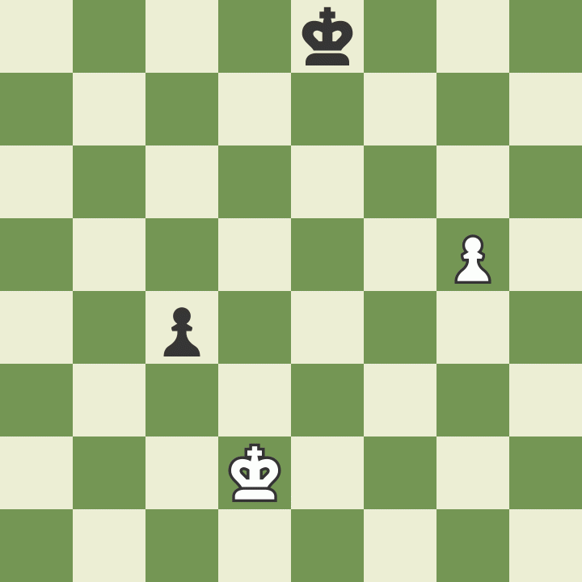
King – All the Points
Can move in any direction
Only can move one square at a time
  The slowest piece on the board

Slide 15
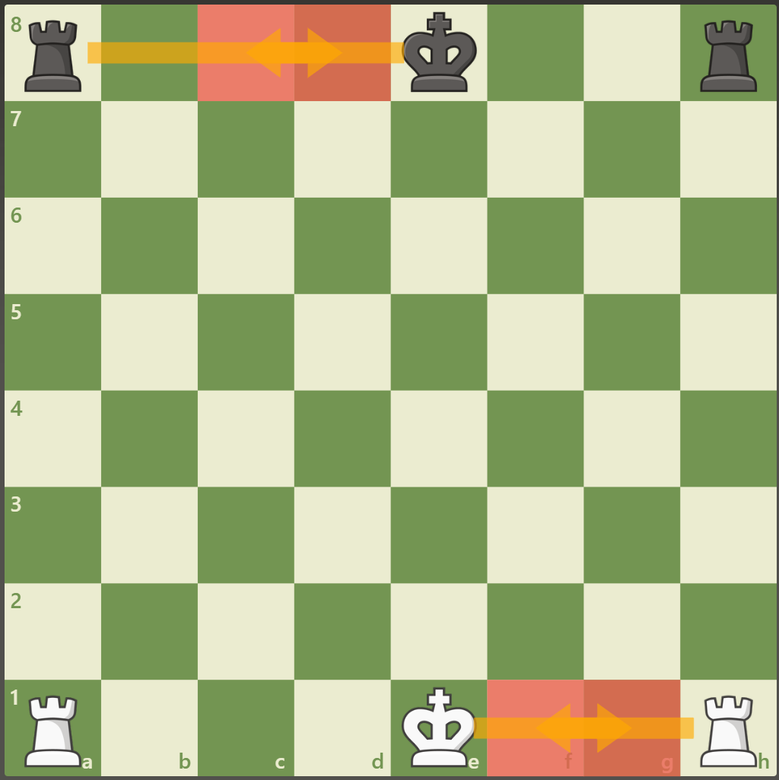
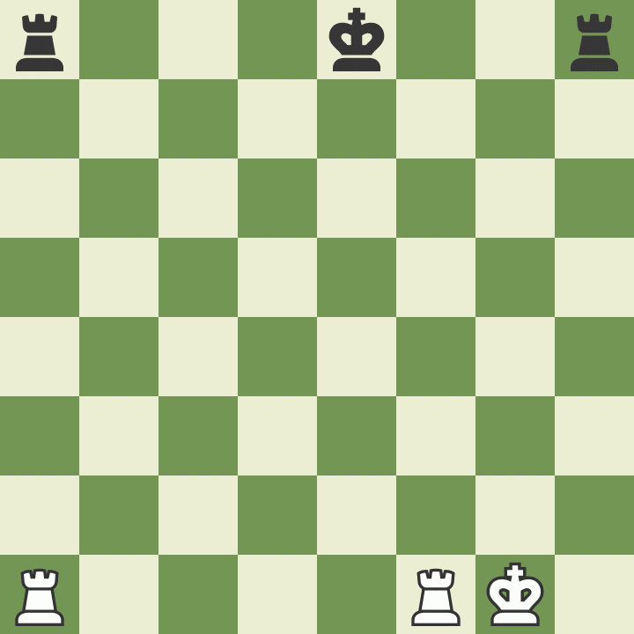
Castling
The only time the king can move more than one square at a time
  King moves two square to the castling side
Castling may be done to the Kingside or the Queenside

Slide 16
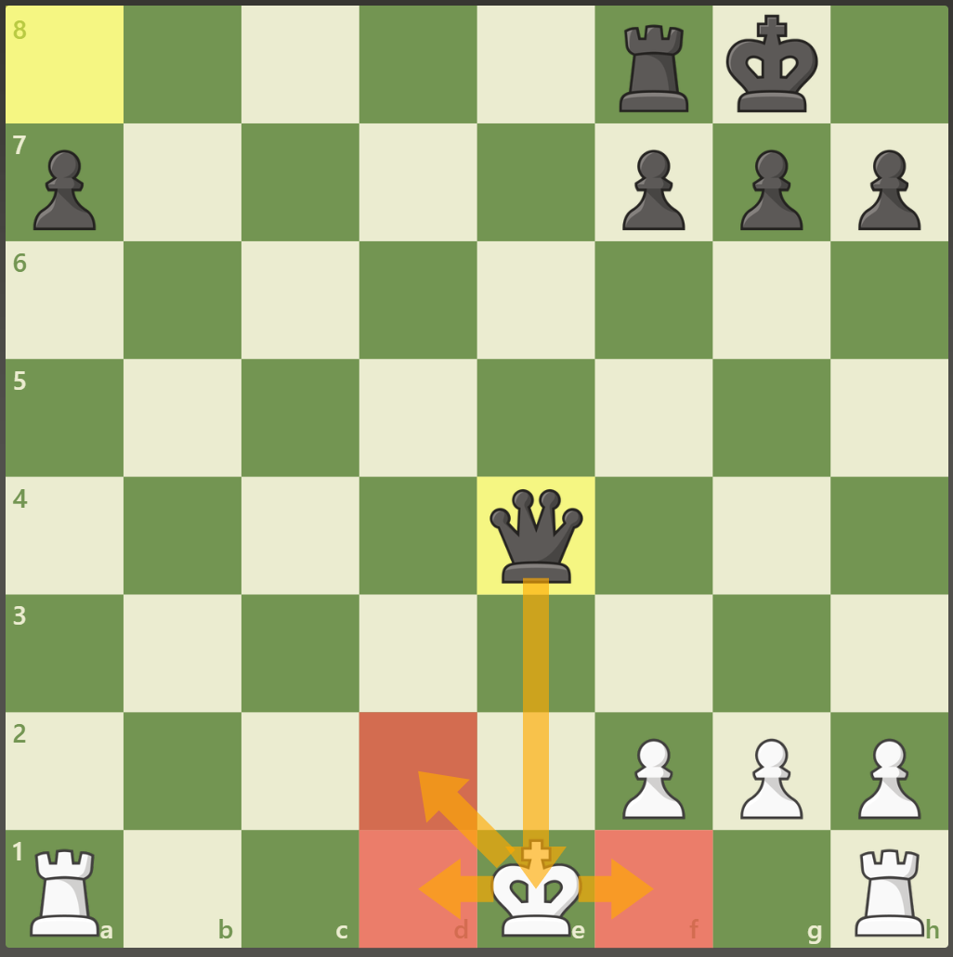
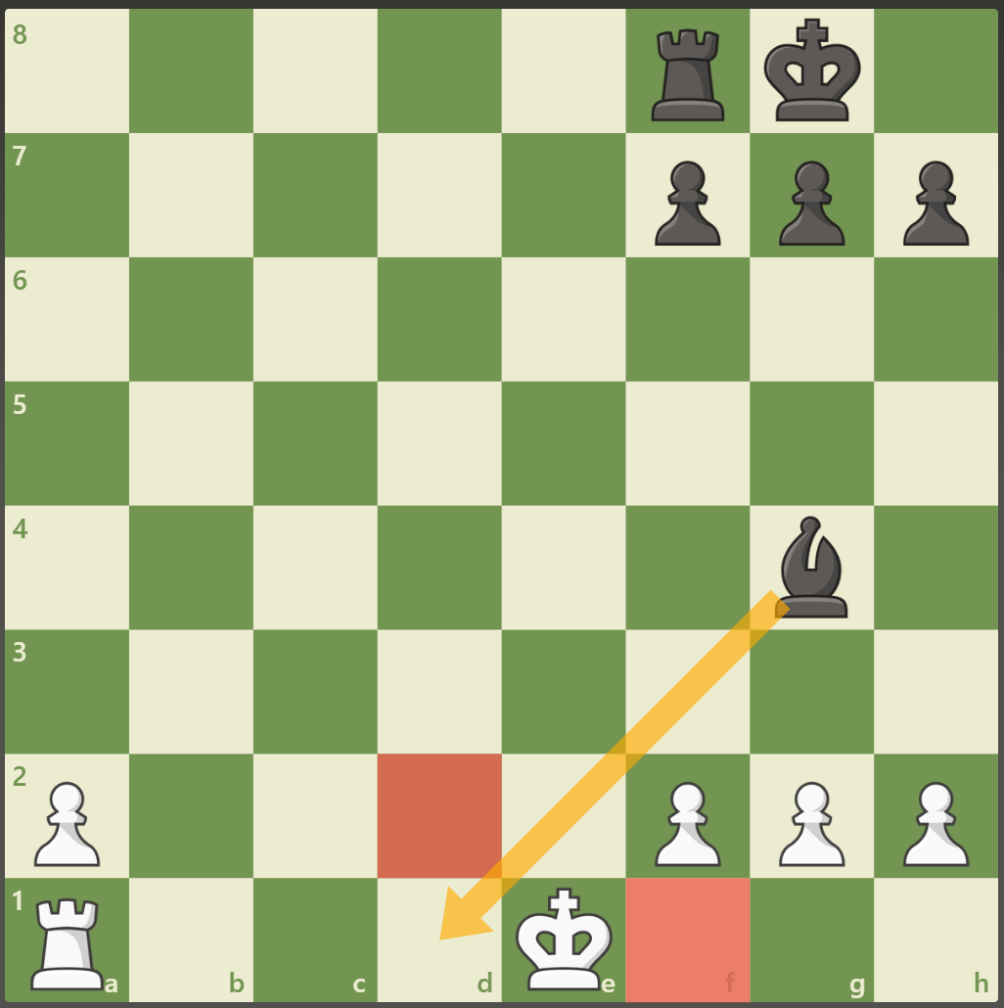
Castling
The only time the king can move more than one square at a time
Castling may be done to the Kingside or the Queenside
Rules of Castling
  Cannot castle out of Check
  Cannot castle through Check
  Cannot castle if either the King or castling rook have already castled

Slide 17
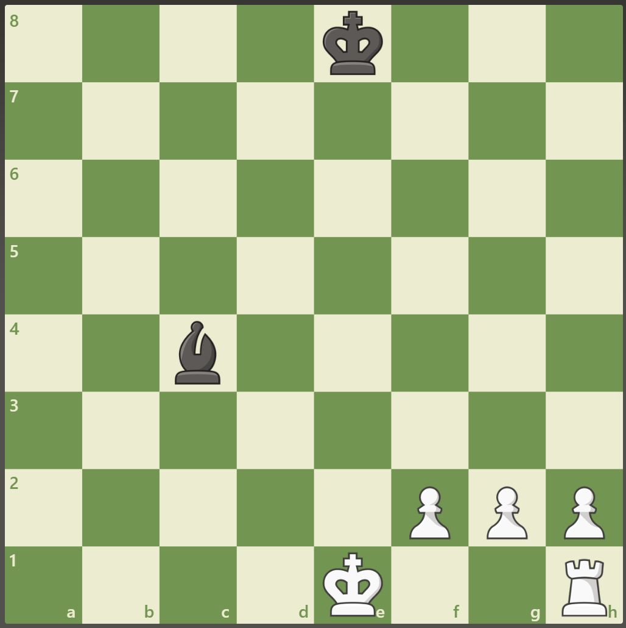
Castling
Can the White King castle?

Slide 18
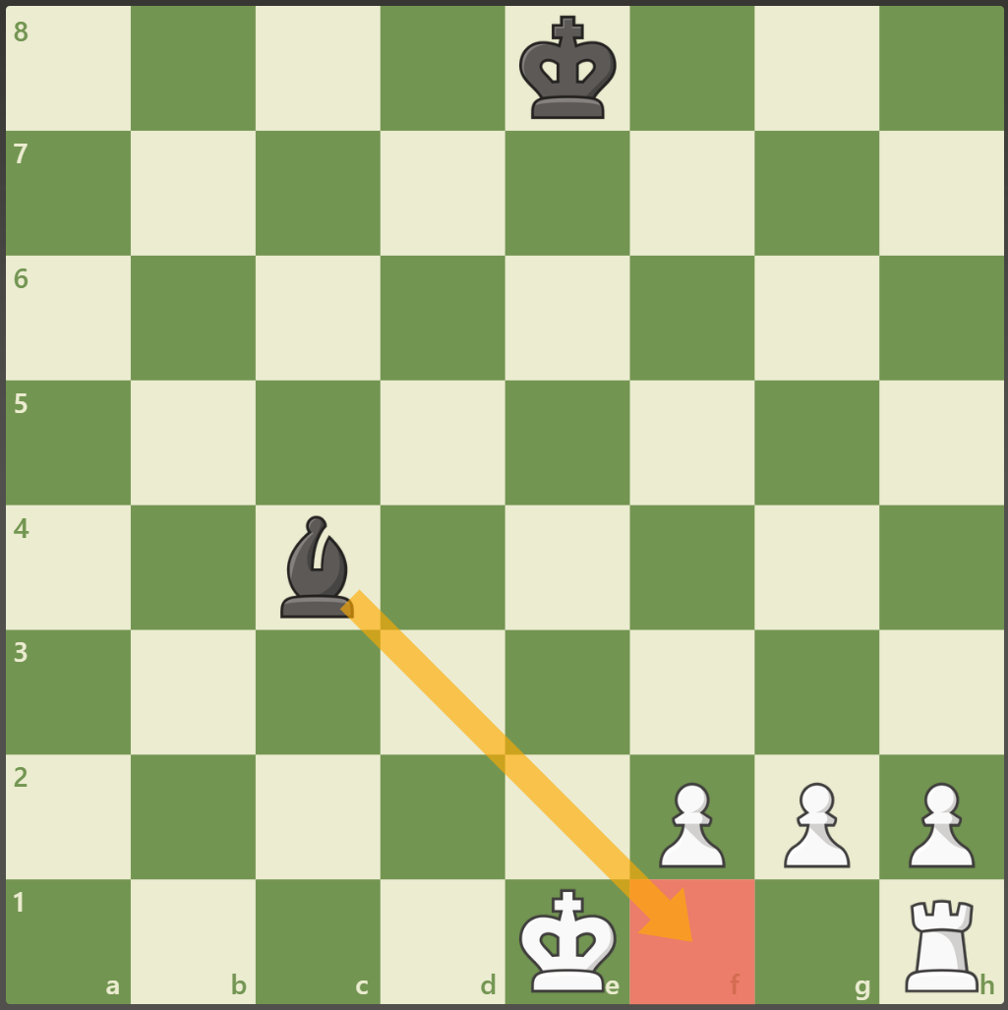
Castling
Can the White King castle?
NO! The king cannot castle through check!

Slide 19
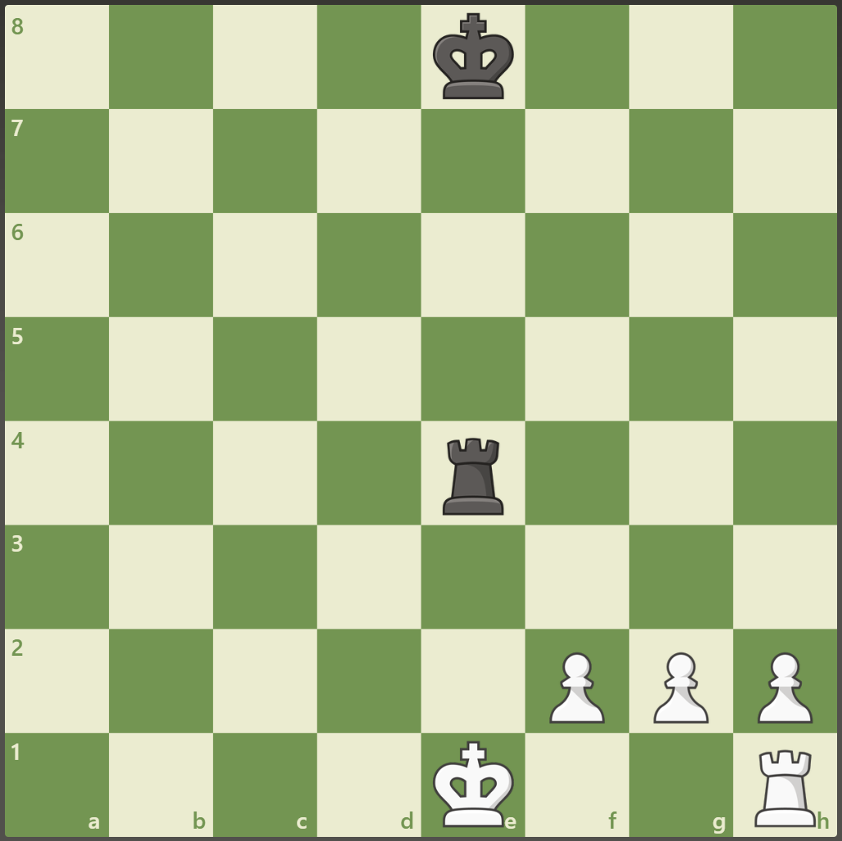
Castling
Can the White King castle?

Slide 20
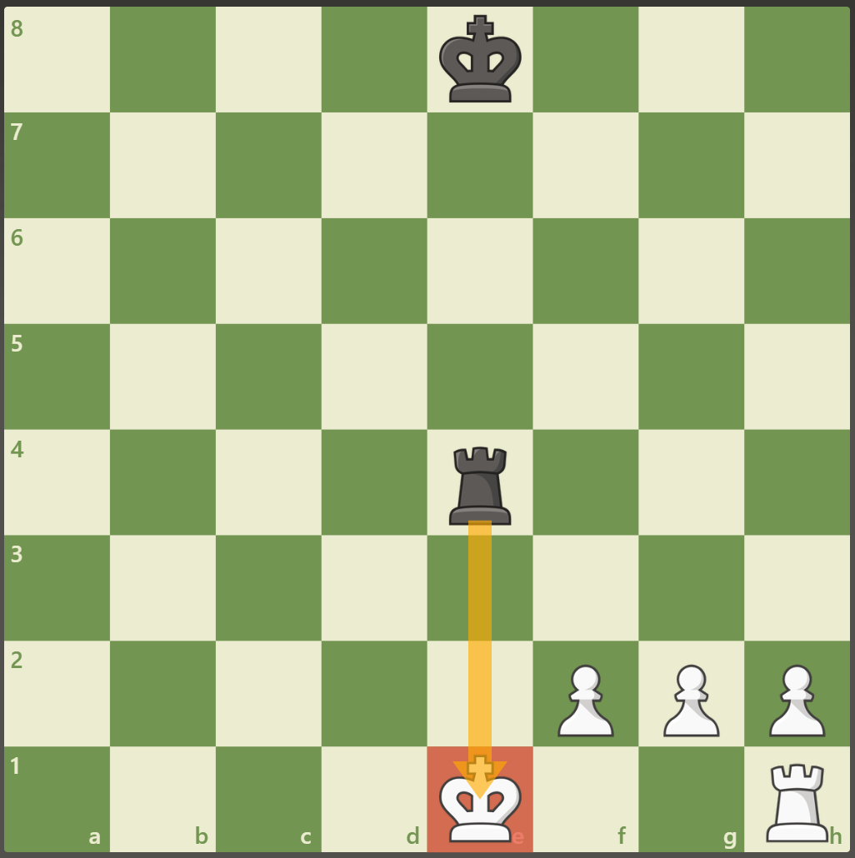
Castling
Can the White King castle?
NO! The king cannot castle while in check!

Slide 21
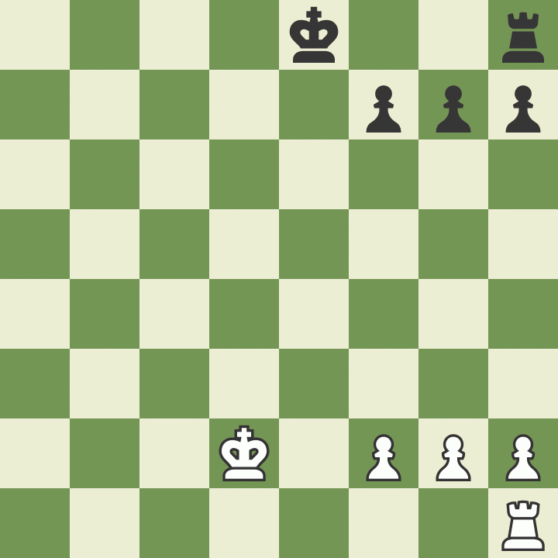
Castling
Can the White King castle?

Slide 22
Castling
Can the White King castle?
NO! The white King has moved therefore can not castle!

Slide 23
Castling
Can the White King castle?
Can the Black King castle?

Slide 24
Castling
Can the White King castle?
Can the Black King castle?
YES! The Black king can castle!

Slide 25
Let’s Play!
Mrs. Ennis
Rusty Charles
Columbiacounty.chess@gmail.com

